Slide 1
BSB WHAM Sensitivity Tests

Slide 2
From FINAL Peer Review Report
Conduct sensitivity analyses including:
1) an exploration of alternative parameterizations for natural mortality (e.g. different age-independent constant values, or age-dependent M) Run 35-36
2) profiles of the initial fishing mortality (i.e. initial depletion)
3) an evaluation of which individual surveys should be included in the VAST index by comparing WHAM estimates (e.g., biomass time series) from the proposed run with individual fishery independent surveys. Surveys that do not appear to accurately reflect changes in stock size through this analysis should not be included in the VAST index.

Slide 3
From FINAL Peer Review Report
Conduct sensitivity analyses including:
1) an exploration of alternative parameterizations for natural mortality (e.g. different age-independent constant values, or age-dependent M)
2) profiles of the initial fishing mortality (i.e. initial depletion)
3) an evaluation of which individual surveys should be included in the VAST index by comparing WHAM estimates (e.g., biomass time series) from the proposed run with individual fishery independent surveys. Surveys that do not appear to accurately reflect changes in stock size through this analysis should not be included in the VAST index.

Slide 4
Sensitivity Tests #3

Slide 5
Options for Sensitivity Item 3
Compare WHAM SSB estimates to the number/tow time series from the individual surveys
Compare WHAM run with run with each index individually, rather than the VAST INDEX -> relax catchability and selectivity
Leave-one-out analysis
Compare WHAM run with just NEFSC BTS, NEAMAP, and RecCPA
Examine current VAST model to see if weighting for each survey could be extracted
Re run VAST with just Spring and Fall NEFSC BTS/ NEAMAP

Slide 6
Options for Sensitivity Item 3
Compare WHAM SSB estimates to the number/tow time series from the individual surveys
Compare WHAM run with run with each index individually, rather than the VAST INDEX
Leave-one-out analysis
Compare WHAM run with just NEFSC BTS, NEAMAP, and RecCPA
Examine current VAST model to see if weighting for each survey could be extracted
Re run VAST with just NEFSC BTS/ NEAMAP

Slide 7
Option 2: Run37
Run 34 Indices
Run 37 Indices
North VAST
Sel RE: 2dar1
Age comp: dir-mult
South VAST
Sel RE: none
Age comp: logistic-normal-ar1-miss0
North
Spring Albatross
NEAMAP
MA
RI
CT
NY
Bigelow
Sel RE: ar1_y for states and NEAMAP except NY which is none. 2dar1 for BTS
Age comp: dir-mult
South
Spring Albatross
NEAMAP
NJ
DE
MD
VIMS
Winter BT
Bigelow
Sel RE: none
Age comp: logistic-normal-ar1-miss0
Notes:
Spring Albatross – 2dar1
NEAMAP – ar1_y
MA – ar1_y
RI – ar1_y
CT – ar1_y
NY- none
Bigelow – 2dar1

Slide 8
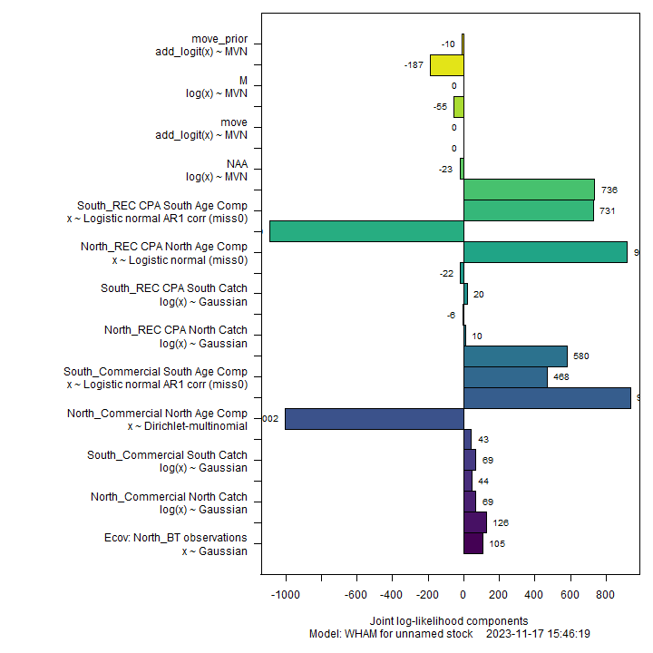
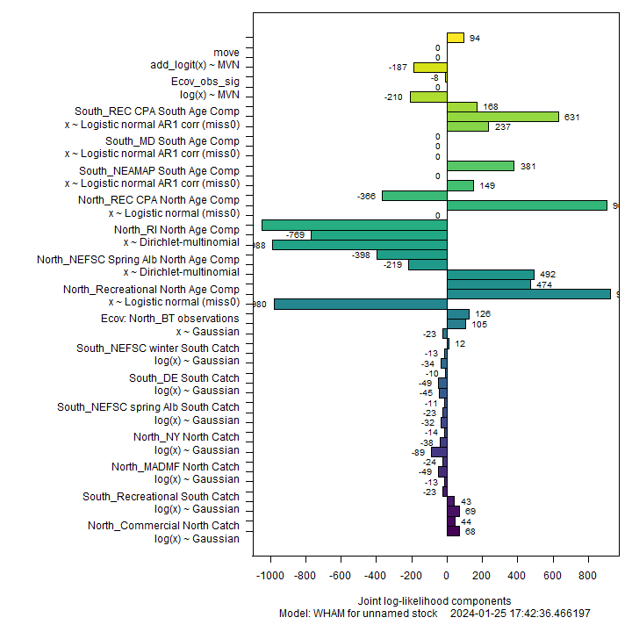
rho_R rho_SSB rho_Fbar
Run34 0.1209 -0.0579 0.0598
Run37.14 0.1333 -0.0067 -0.0159
Notes:
Interesting difference in convergence messages:
check_convergence(fit) stats:nlminb thinks the model has converged: mod$opt$convergence == 0 Maximum gradient component: 1.49e-11 Max gradient parameter: log_NAA_sigma TMB:sdreport() was performed successfully for this model >
check_convergence(fit2) stats:nlminb thinks the model has converged: mod$opt$convergence == 0 Maximum gradient component: 1.89e-08 Max gradient parameter: index_paa_pars TMB:sdreport() was performed successfully for this model

Slide 9
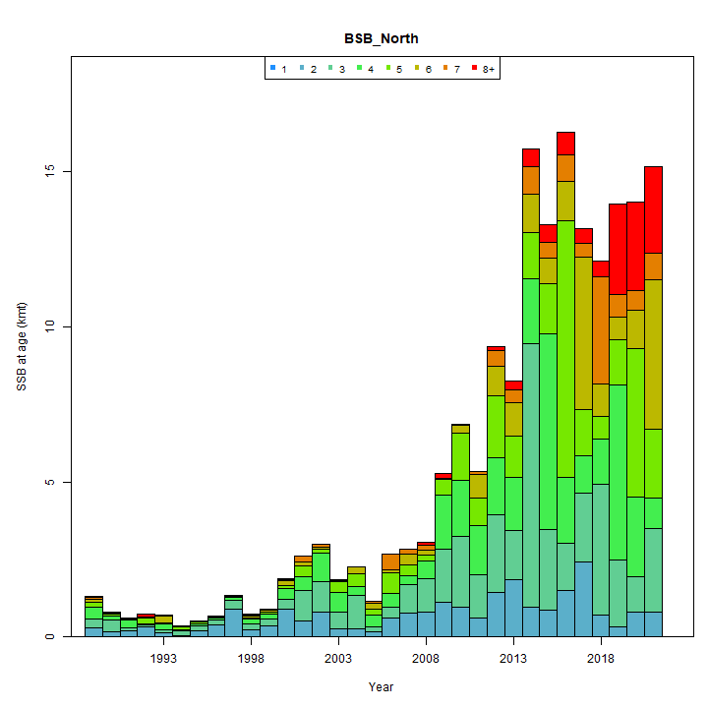
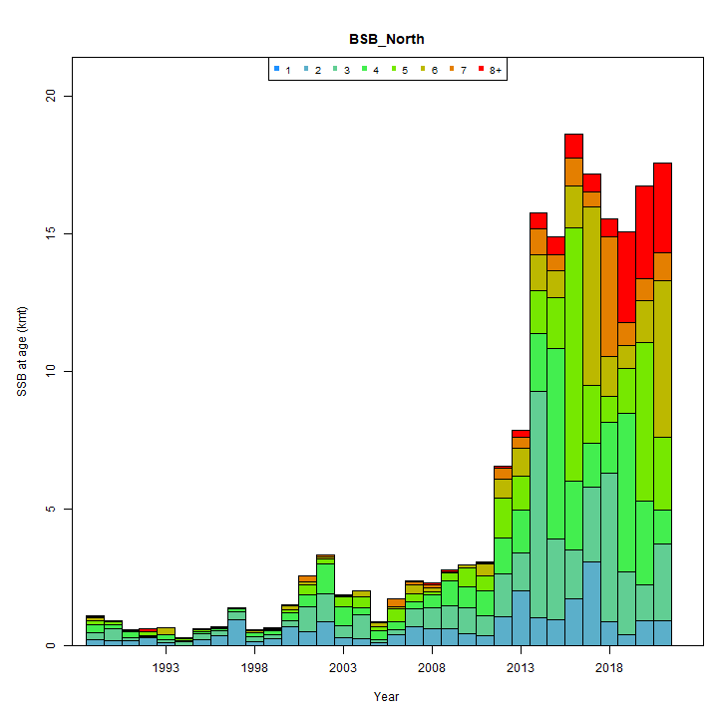
Run 34
Run 37

Slide 10
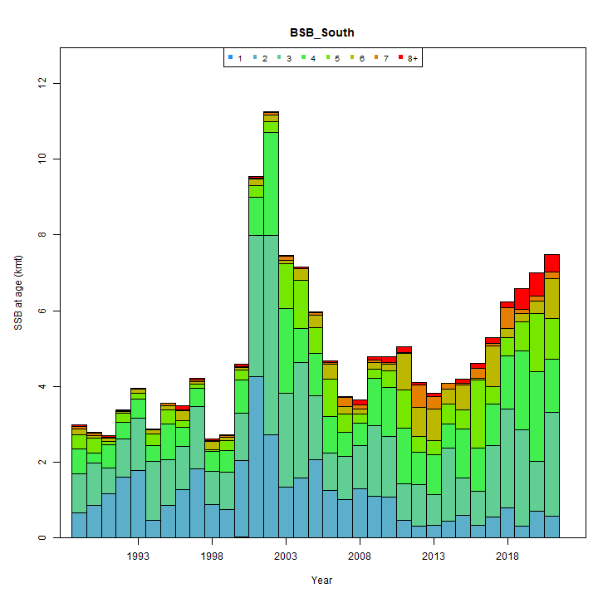
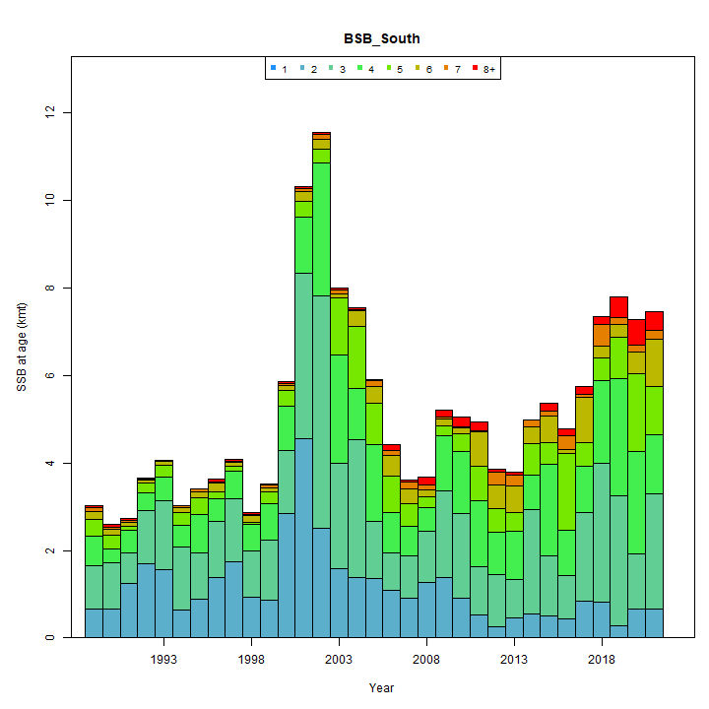
Run 34
Run 37

Slide 11
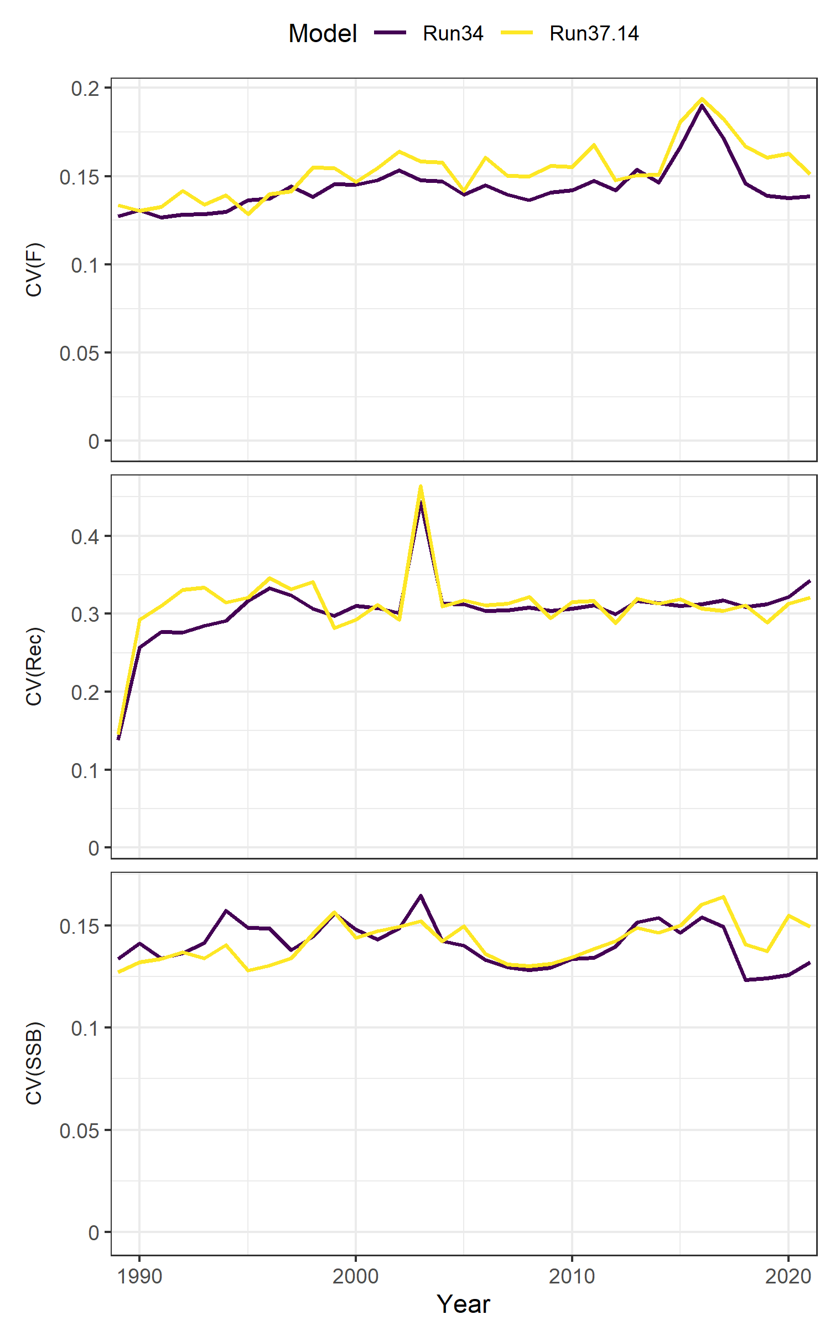
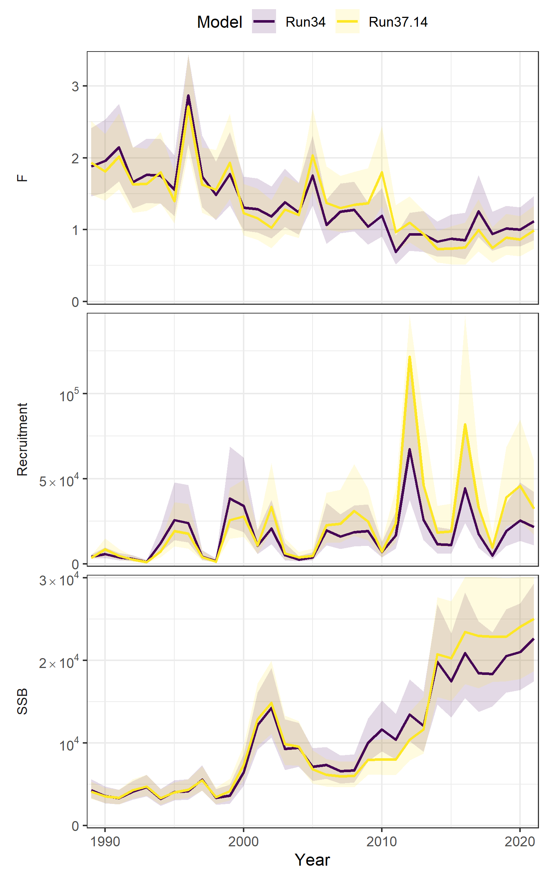
Notes:
Not sure this value or what’s going on with CV, this value itself isn’t output in WHAM

Slide 12
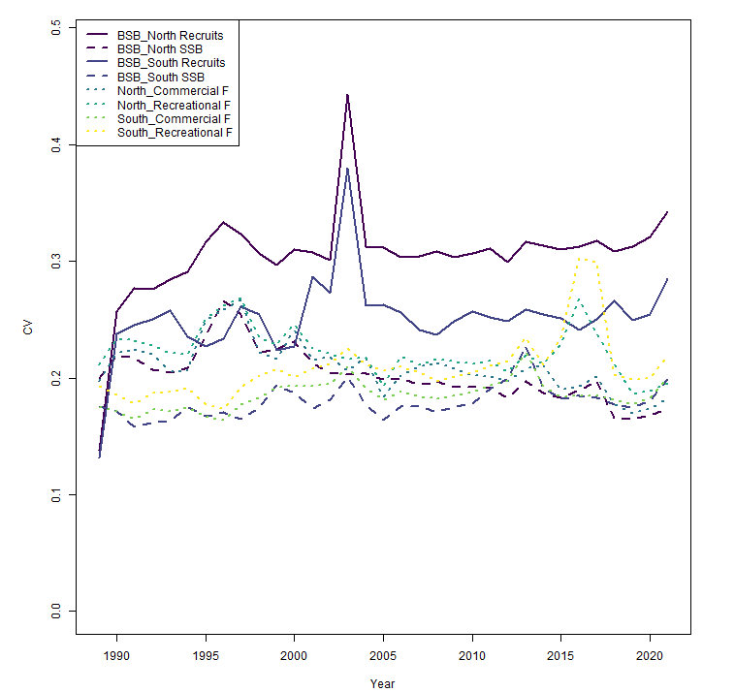
Run 34, shows that this CV spike is in North and South:

Slide 13
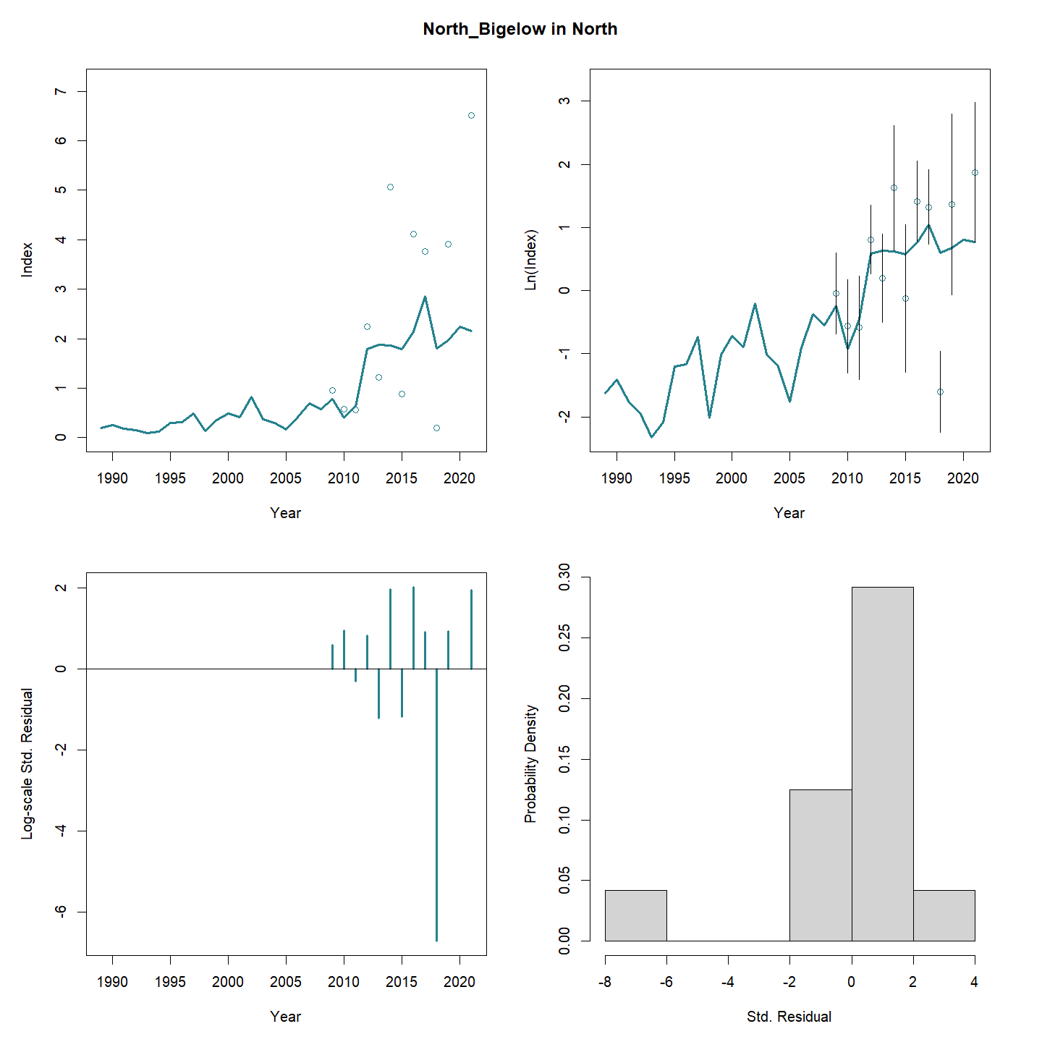

Slide 14
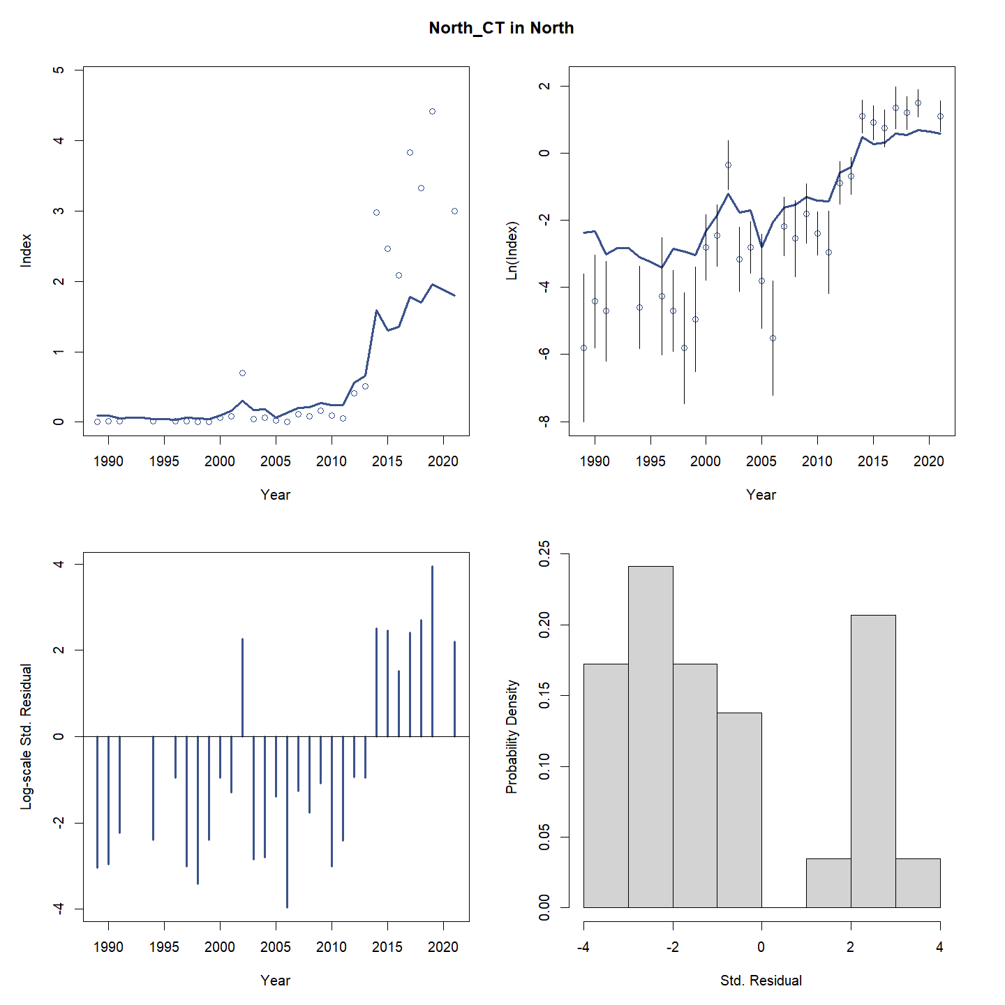

Slide 15
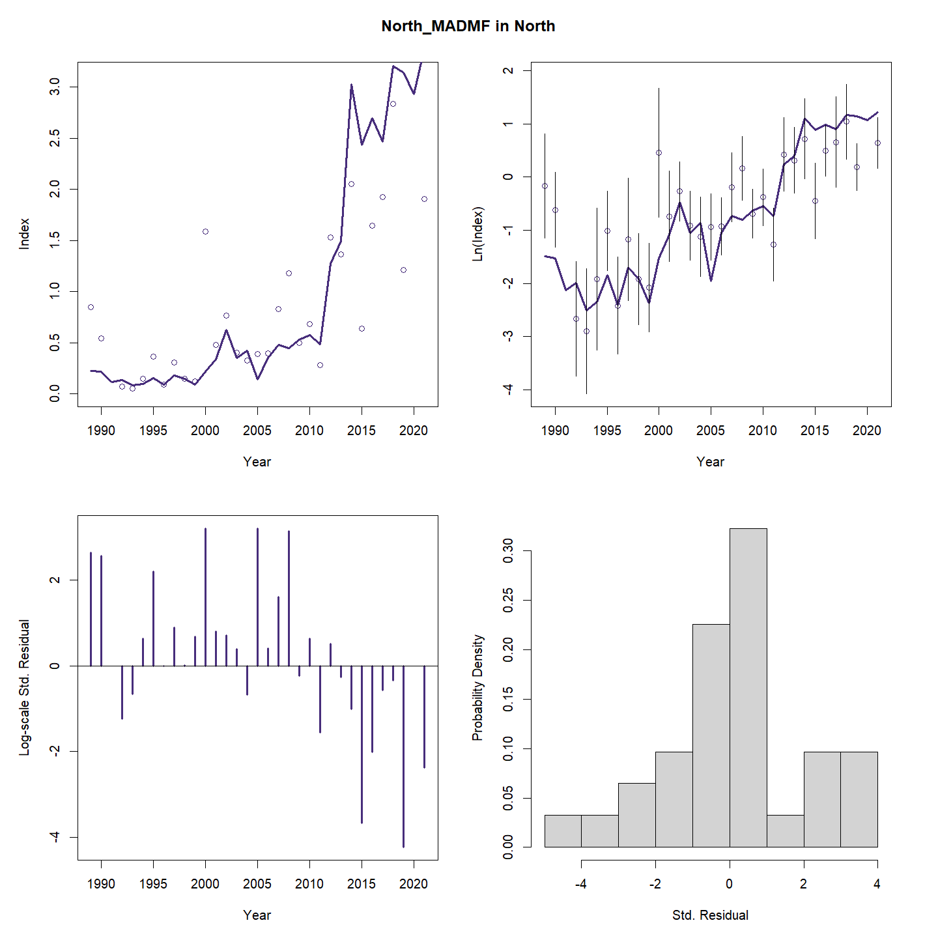

Slide 16
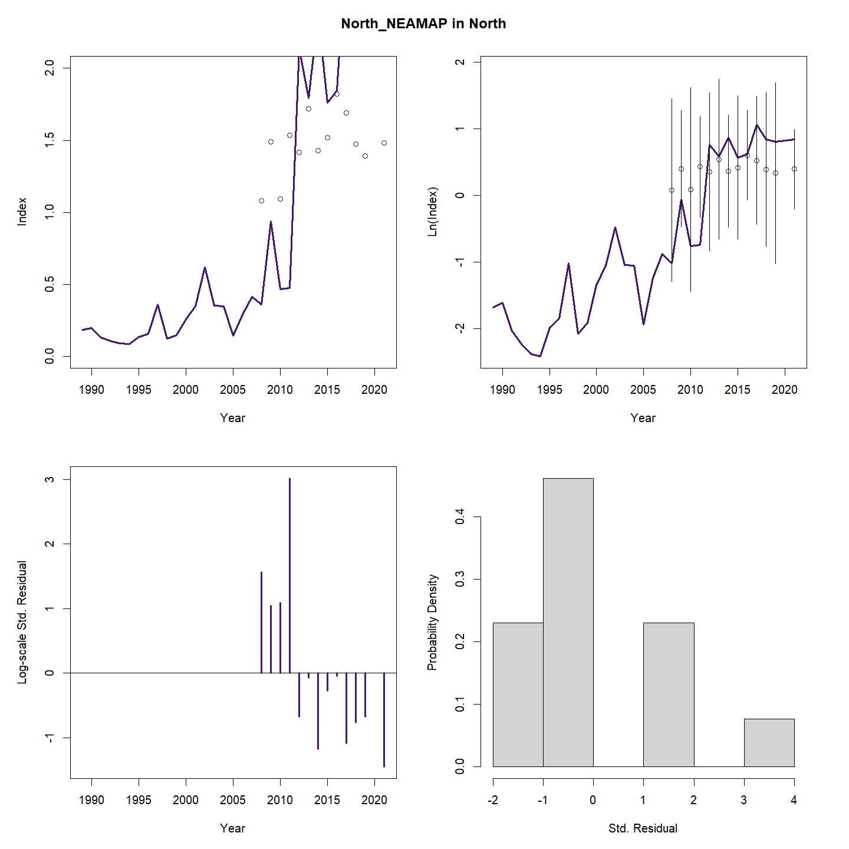

Slide 17
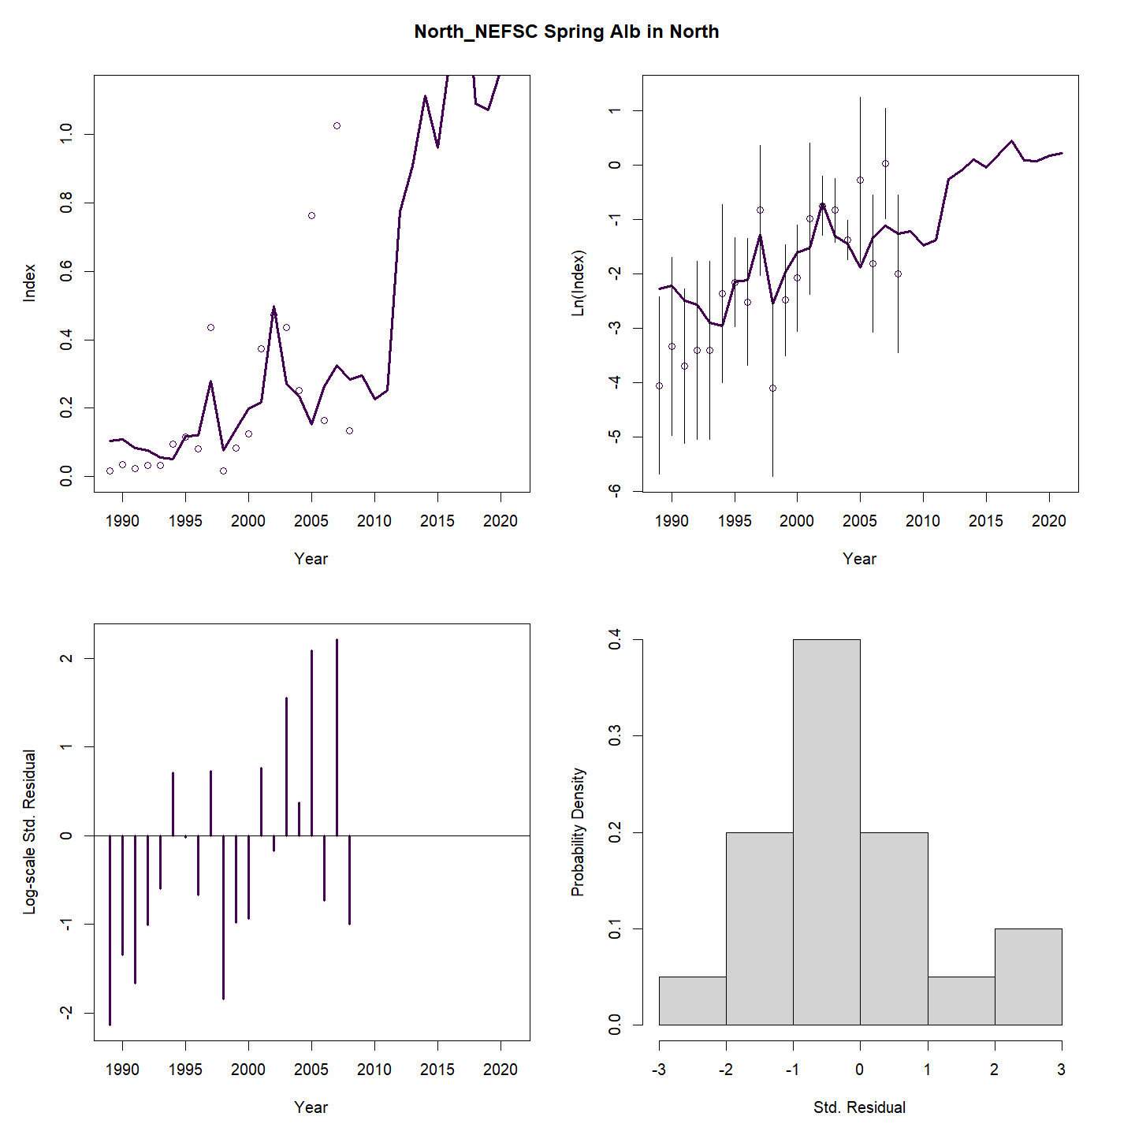

Slide 18
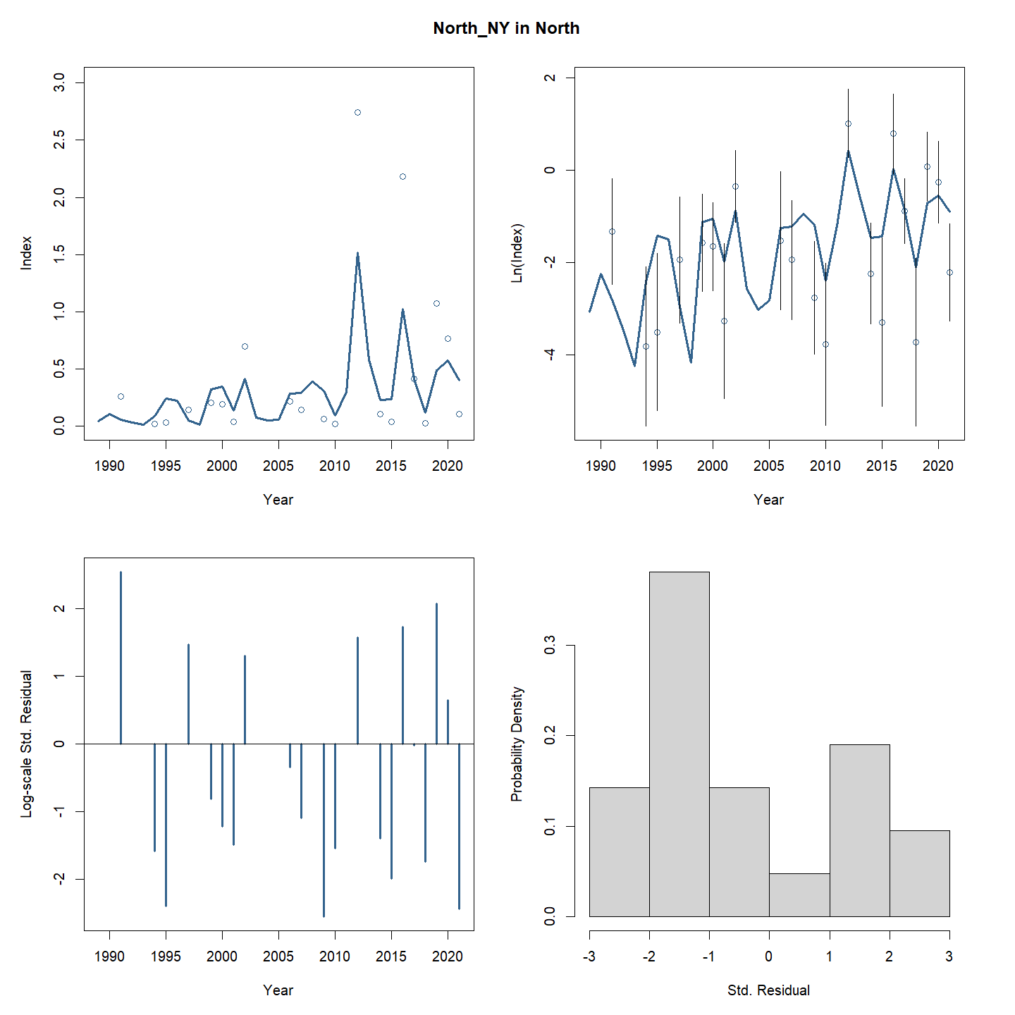

Slide 19
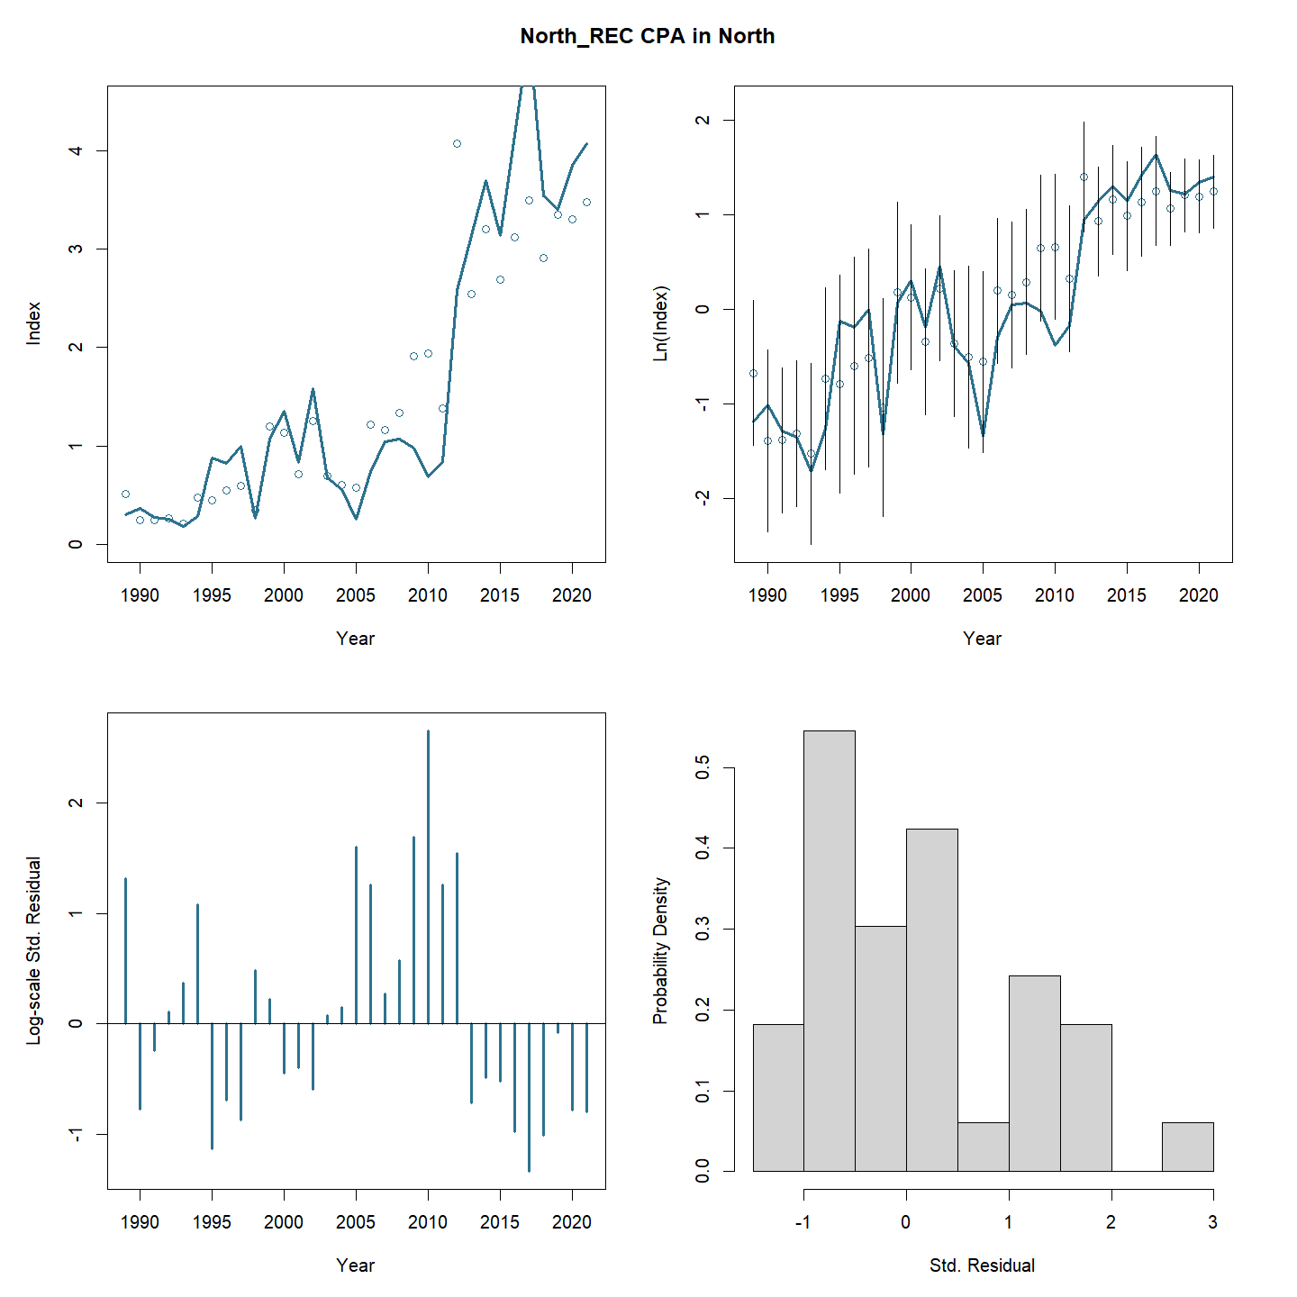

Slide 20
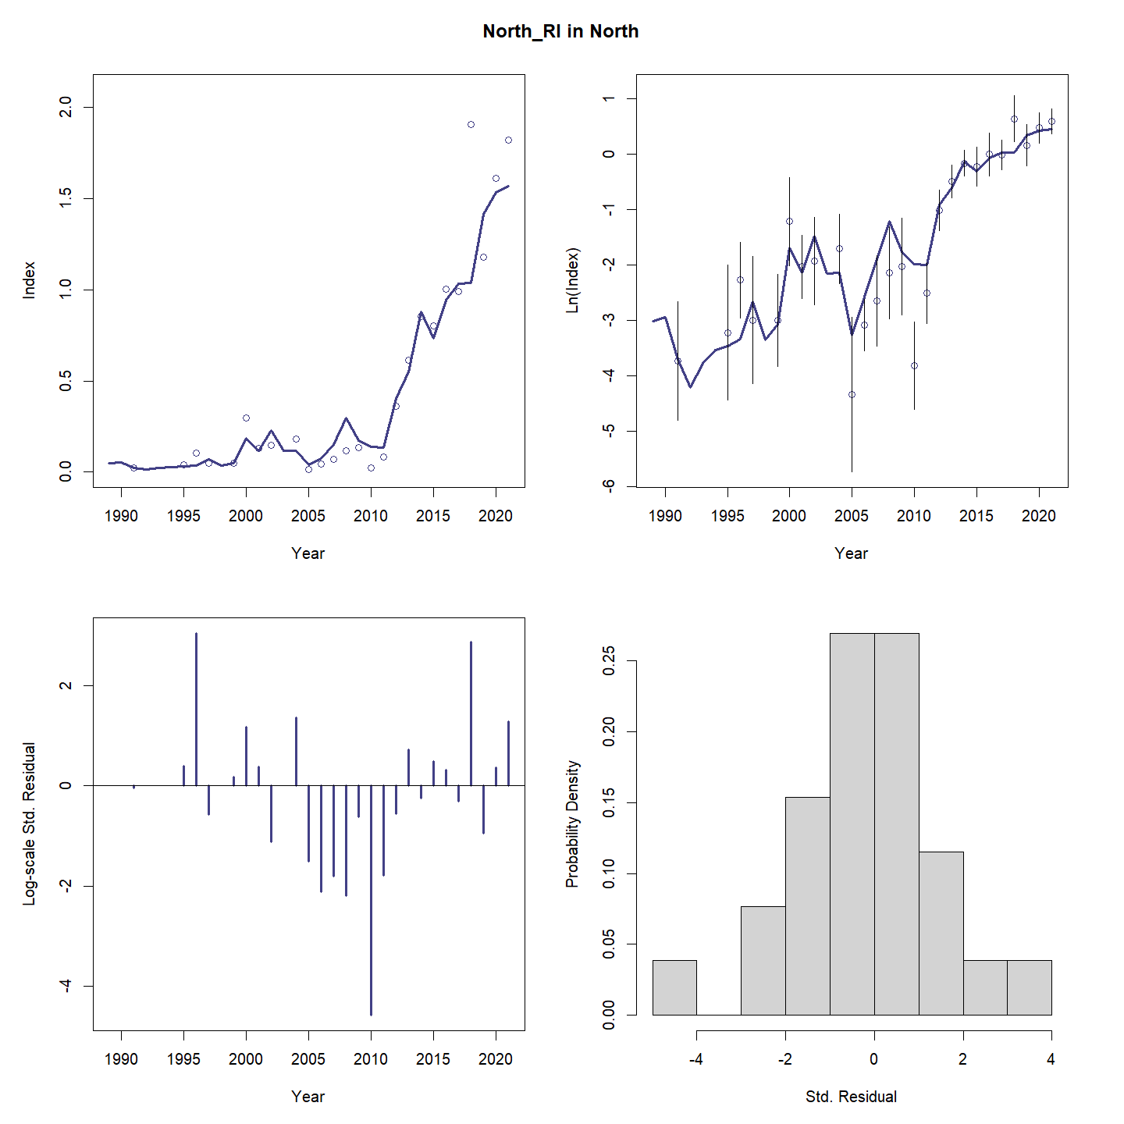

Slide 21
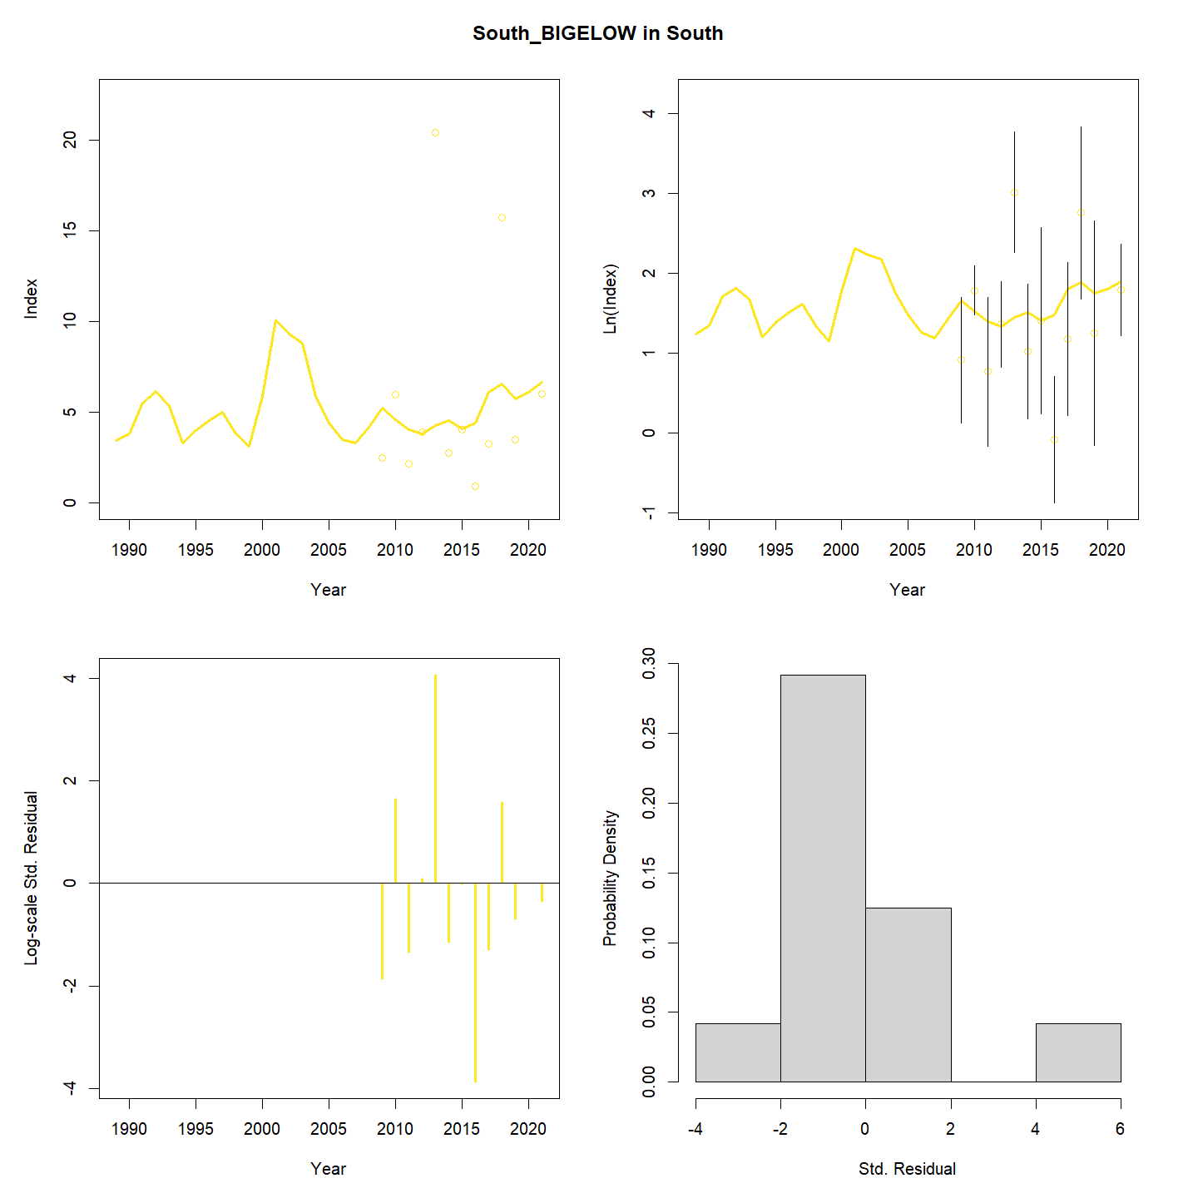

Slide 22
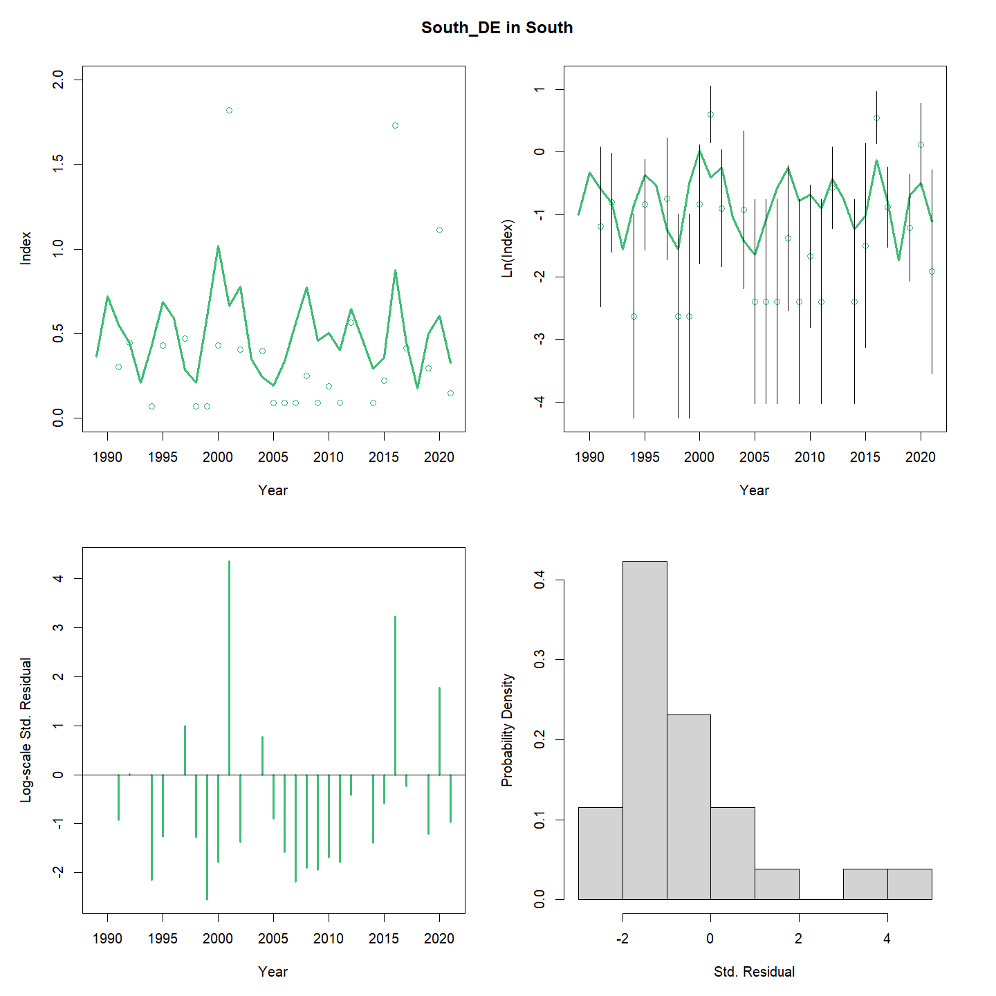

Slide 23
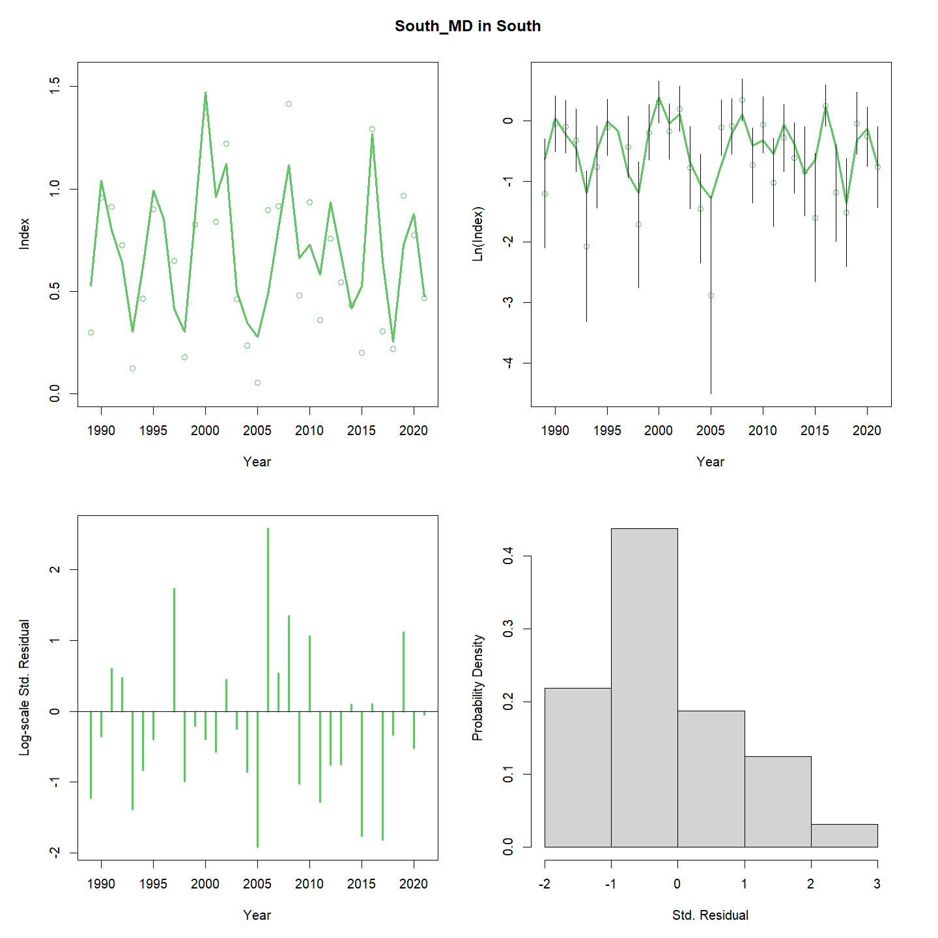

Slide 24
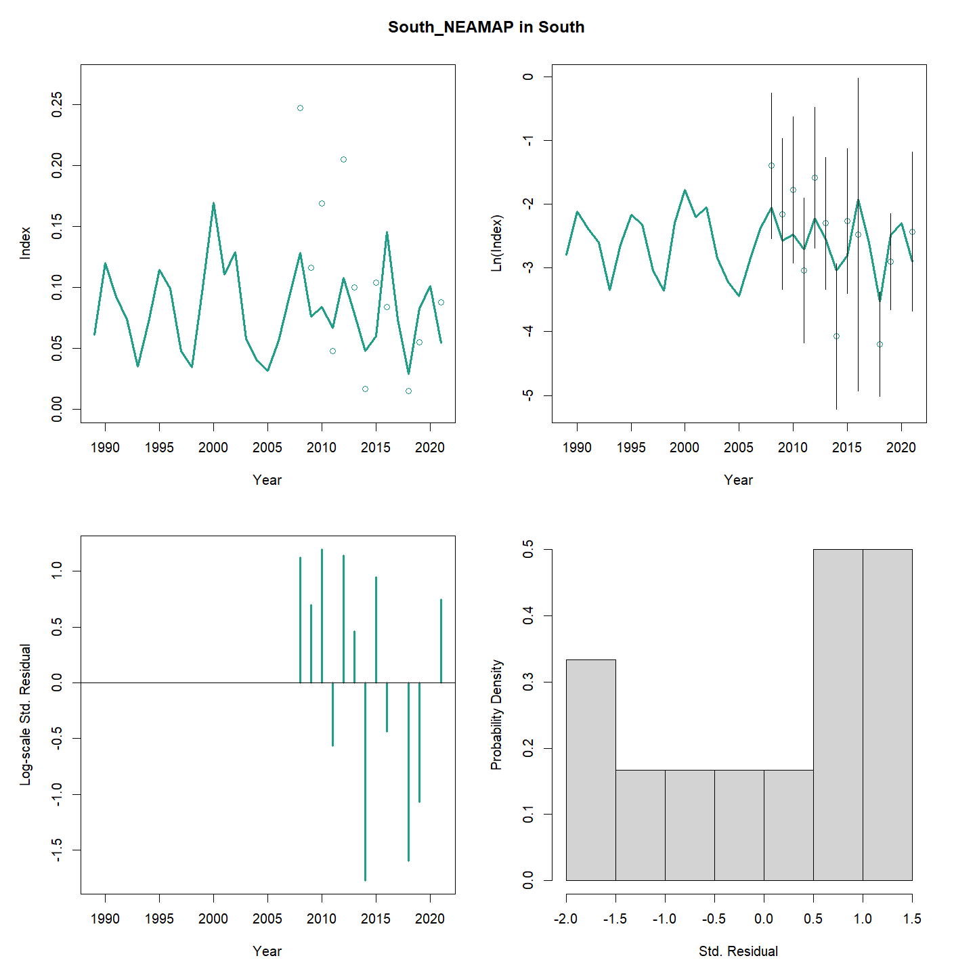

Slide 25
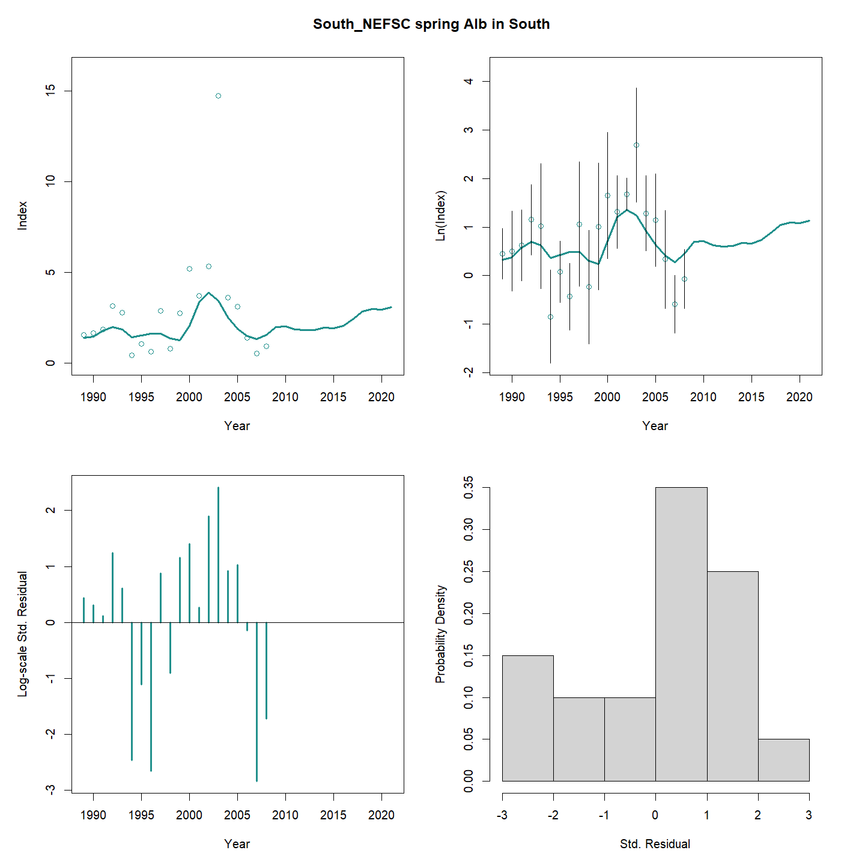

Slide 26
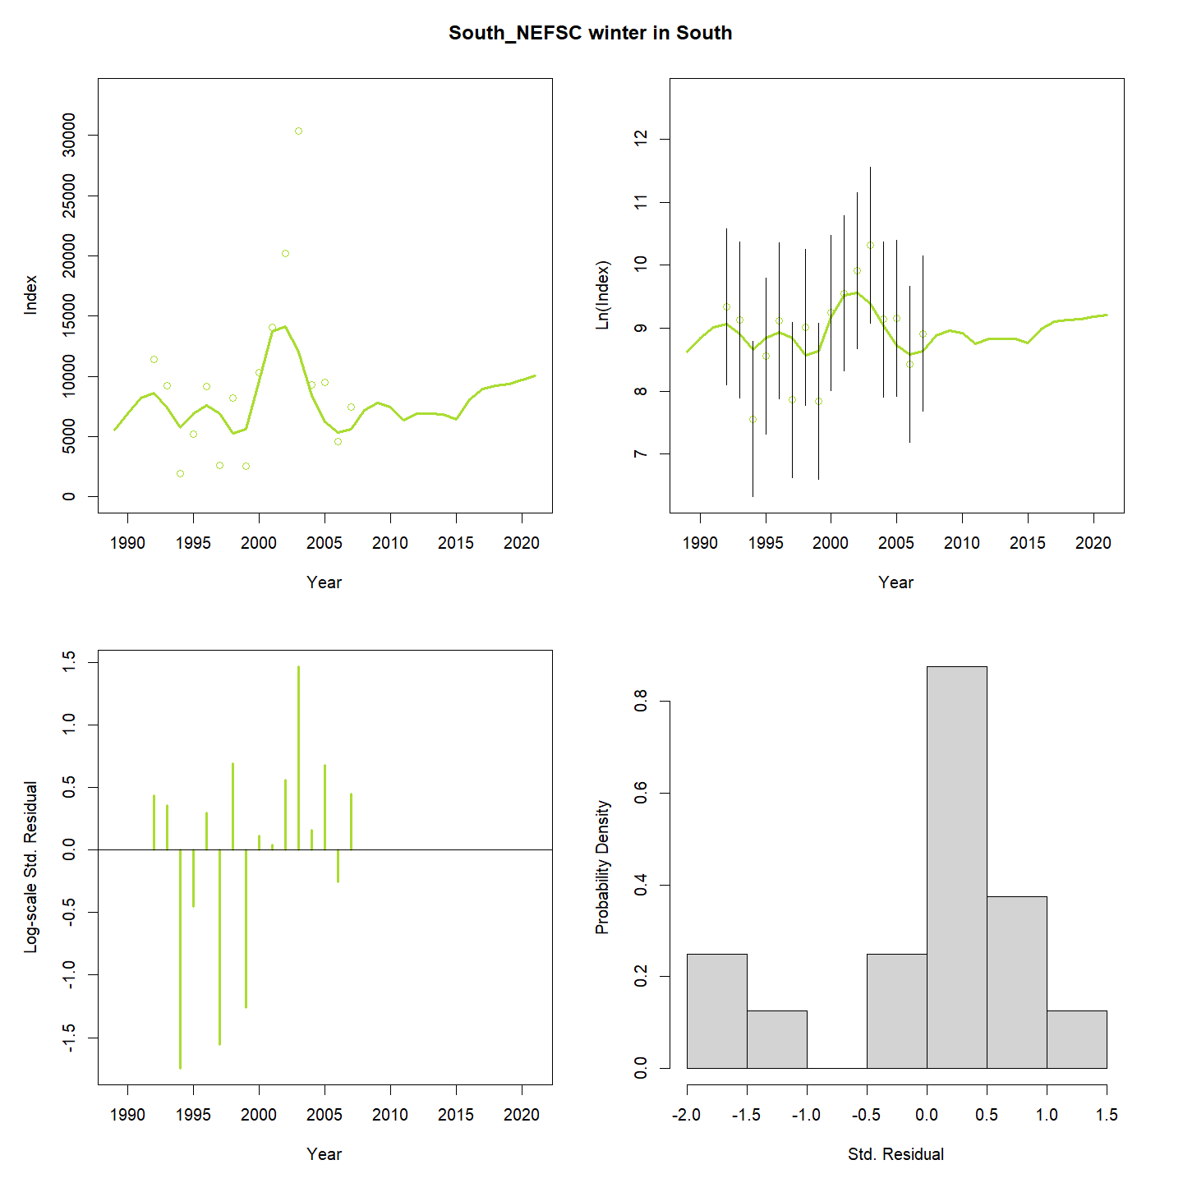

Slide 27
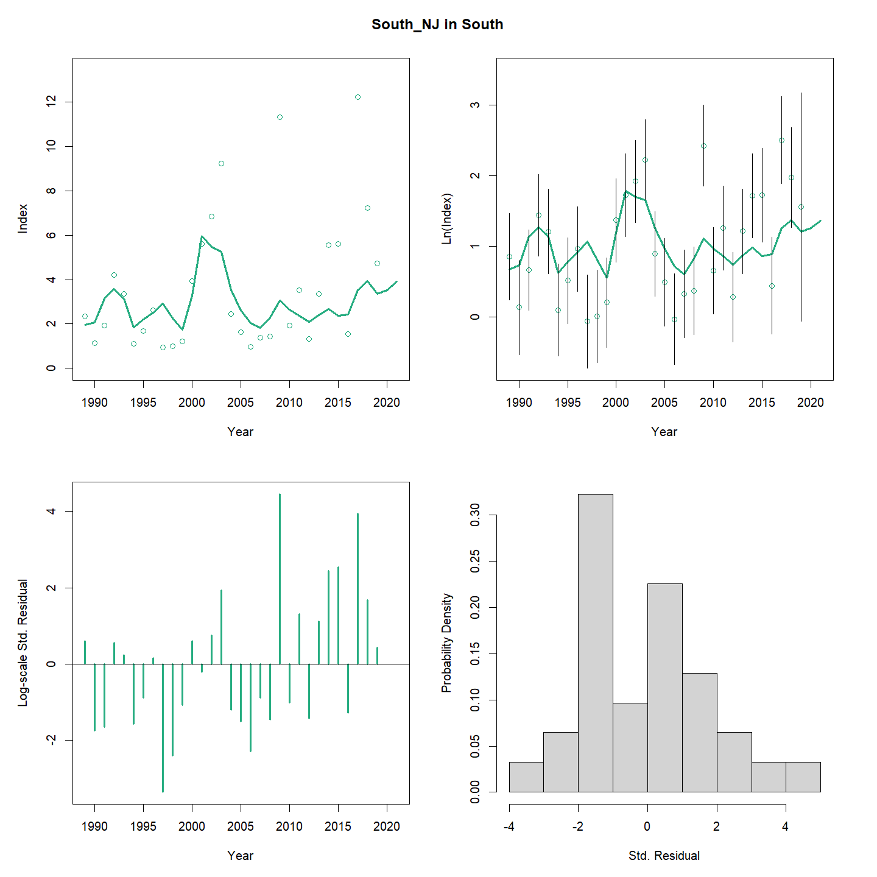

Slide 28
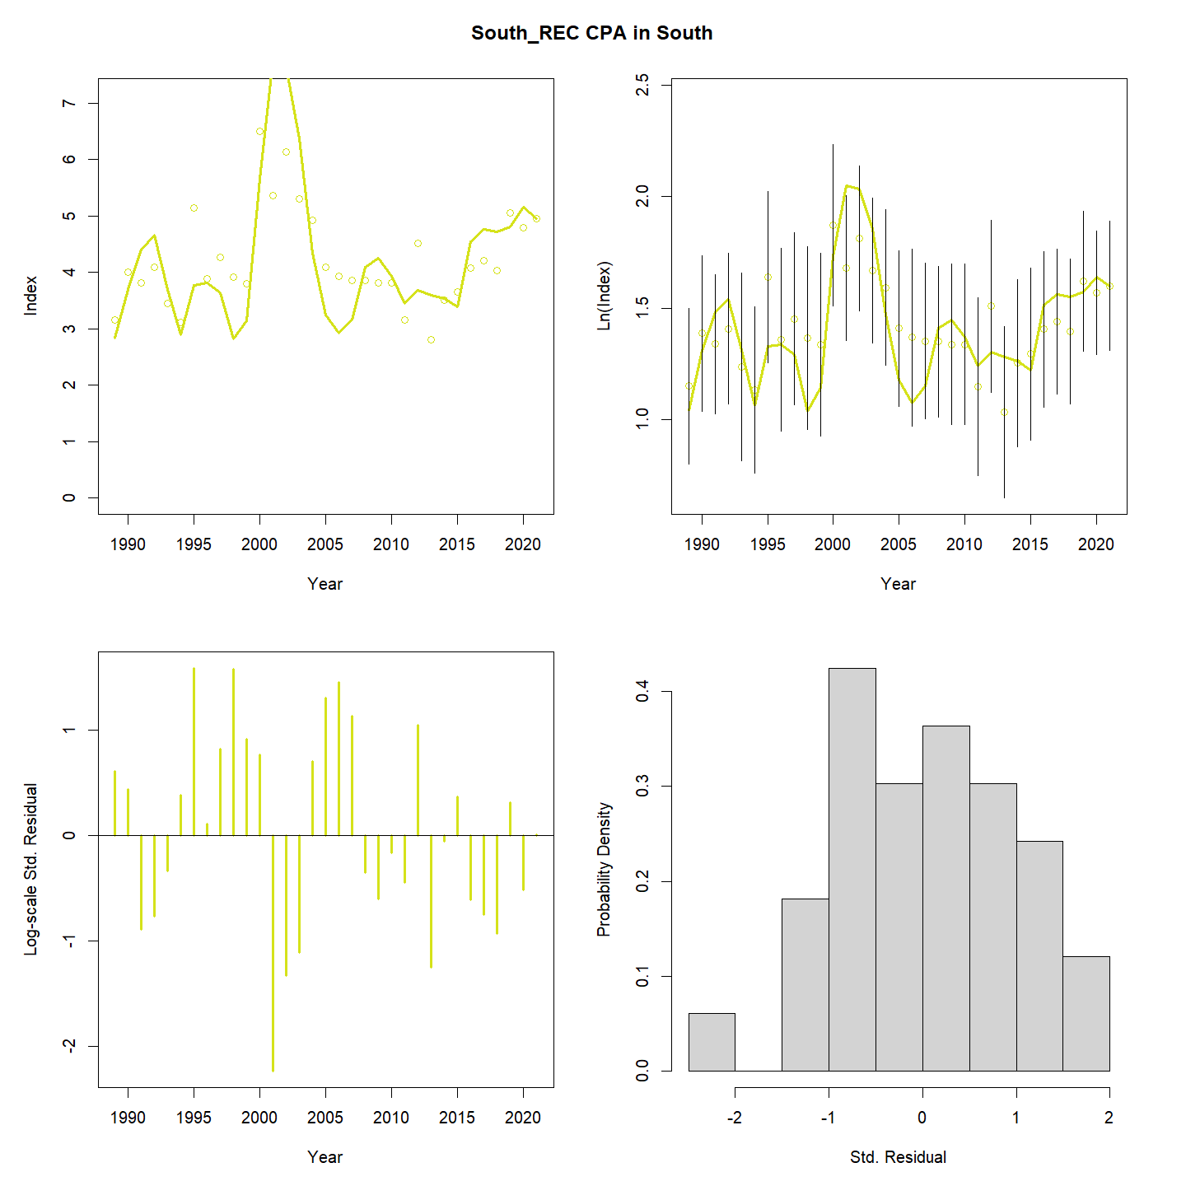

Slide 29
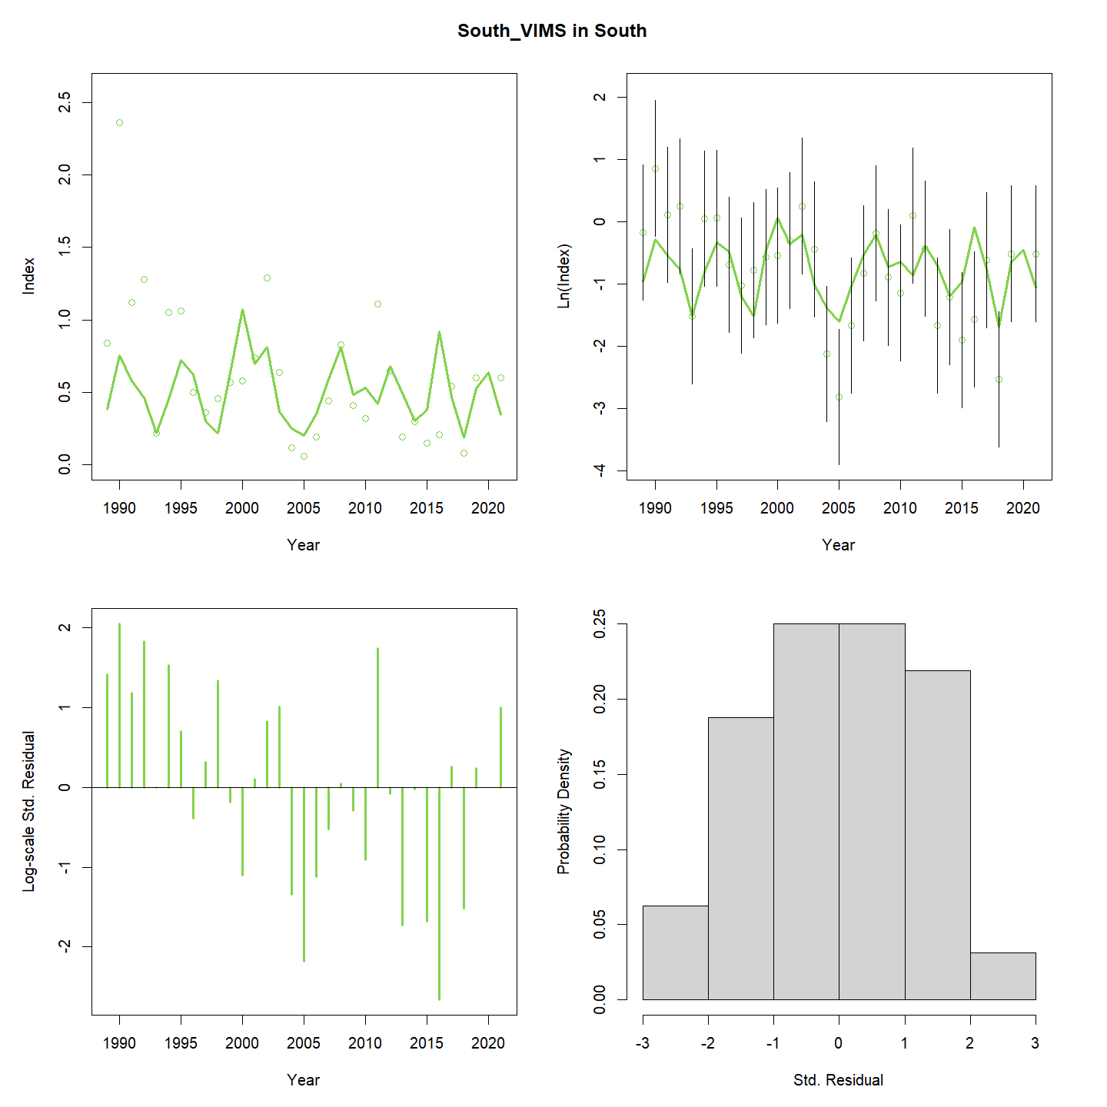

Slide 30
Options for Sensitivity Item 3
Compare WHAM SSB estimates to the number/tow time series from the individual surveys
Compare WHAM run with run with each index individually, rather than the VAST INDEX
Leave-one-out analysis
Compare WHAM run with just NEFSC BTS, NEAMAP, and RecCPA
Examine current VAST model to see if weighting for each survey could be extracted
Re run VAST with just NEFSC BTS/ NEAMAP

Slide 31
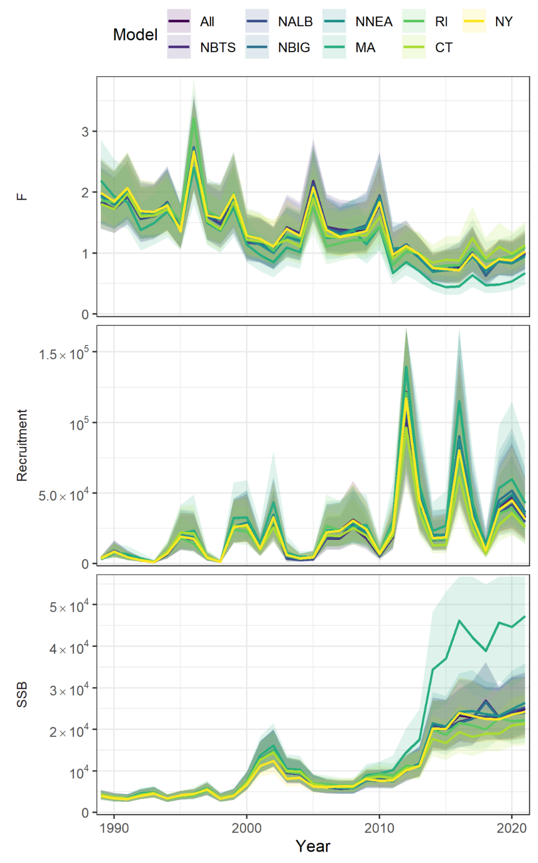
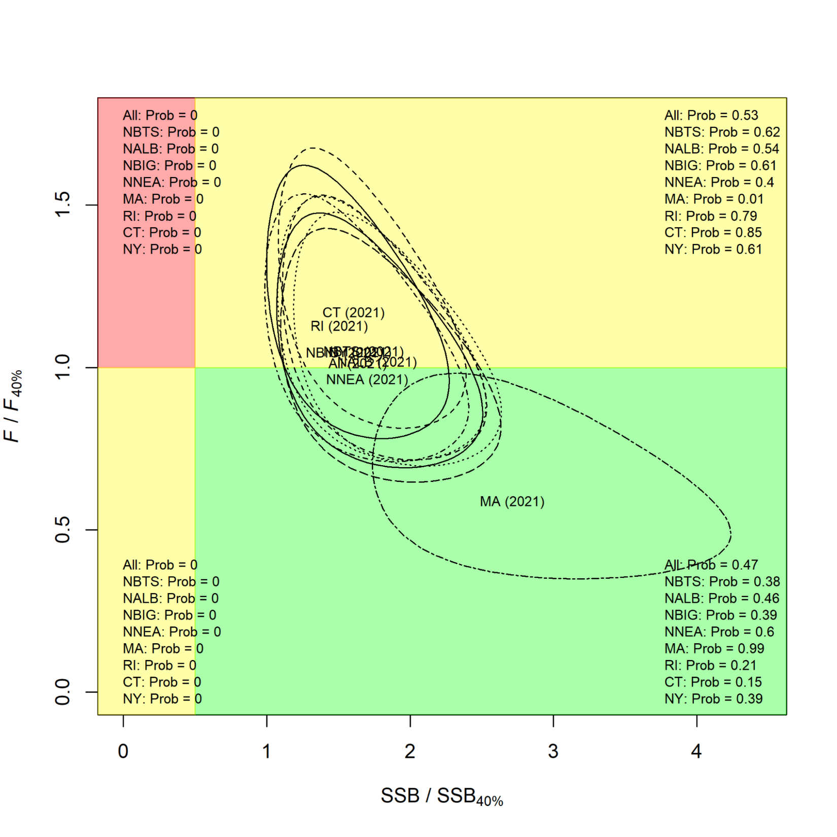

Slide 32
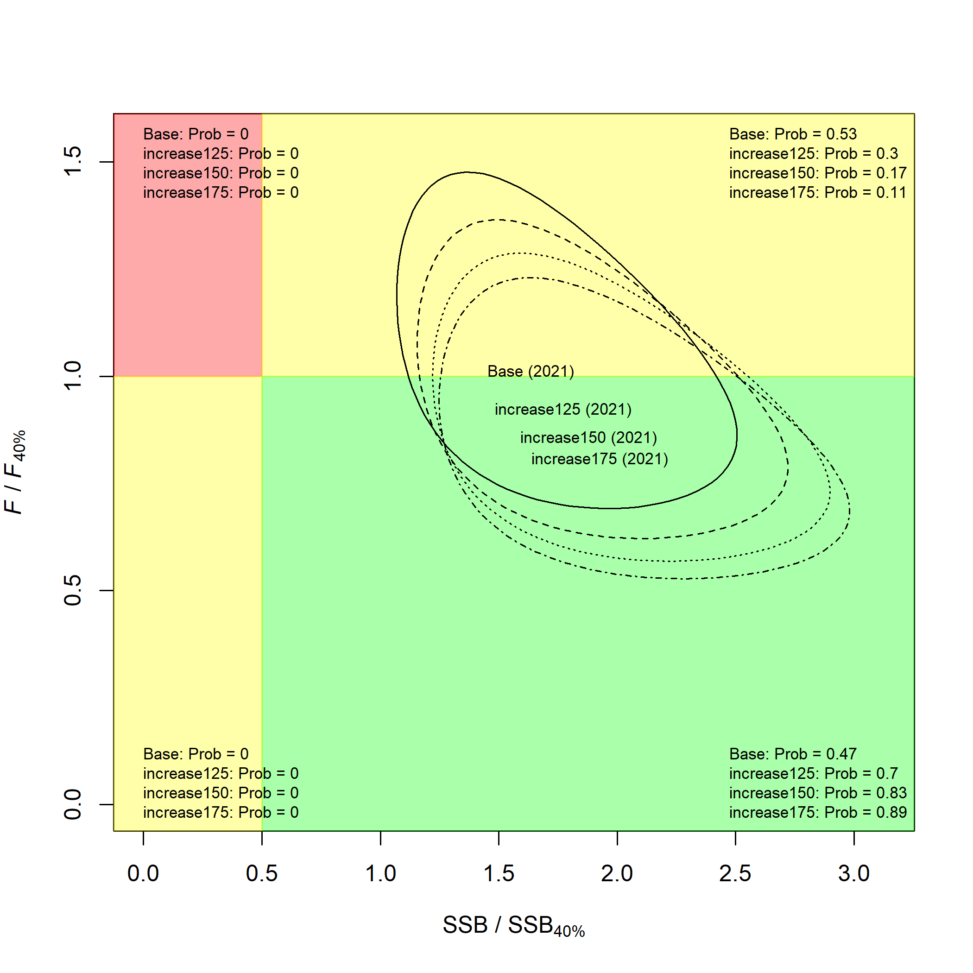

Slide 33
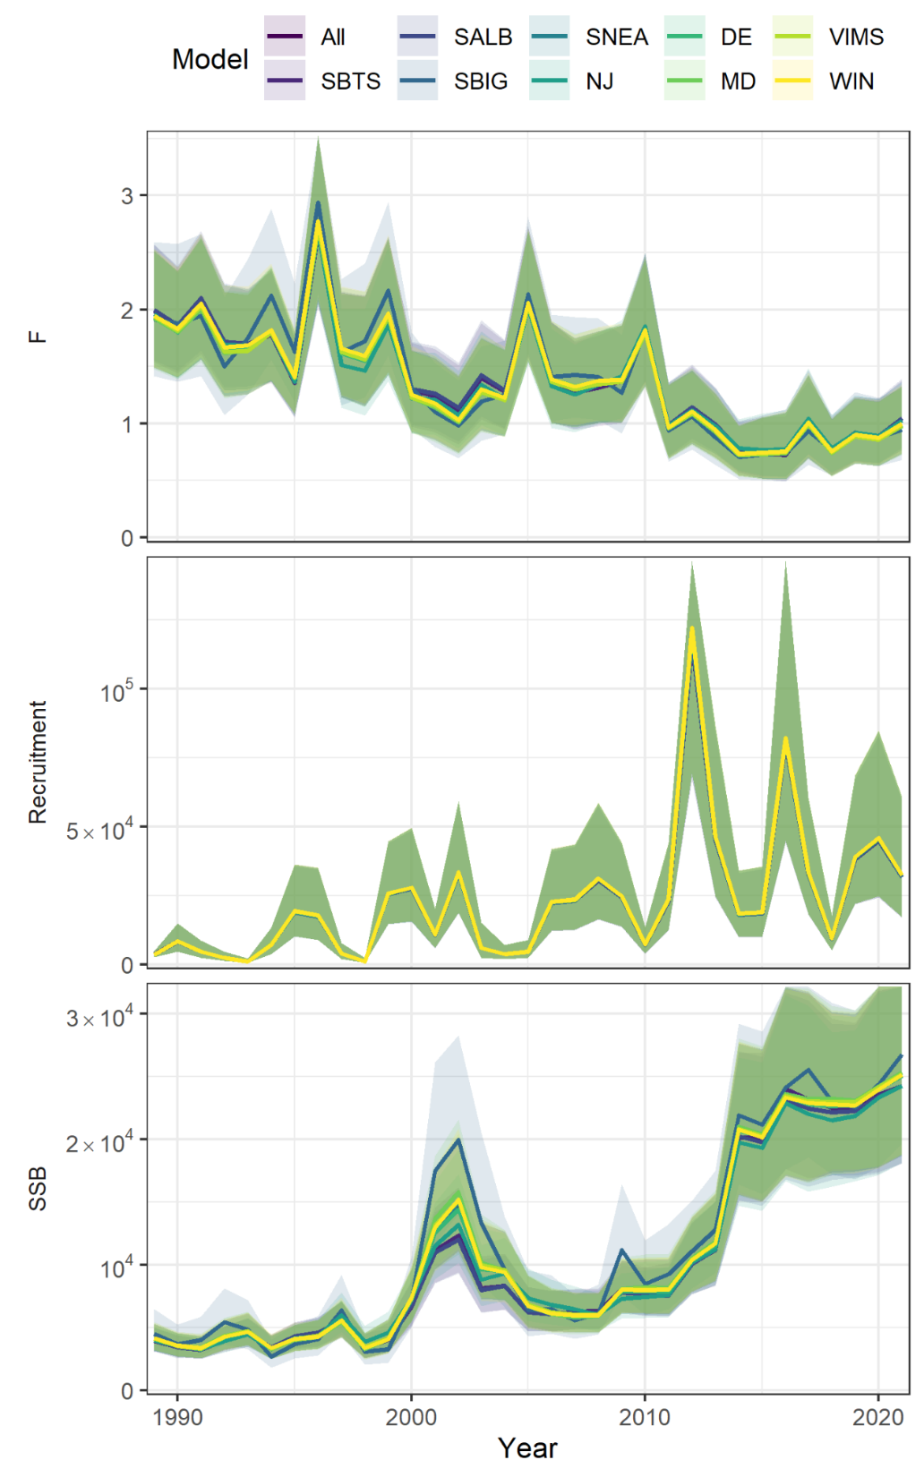
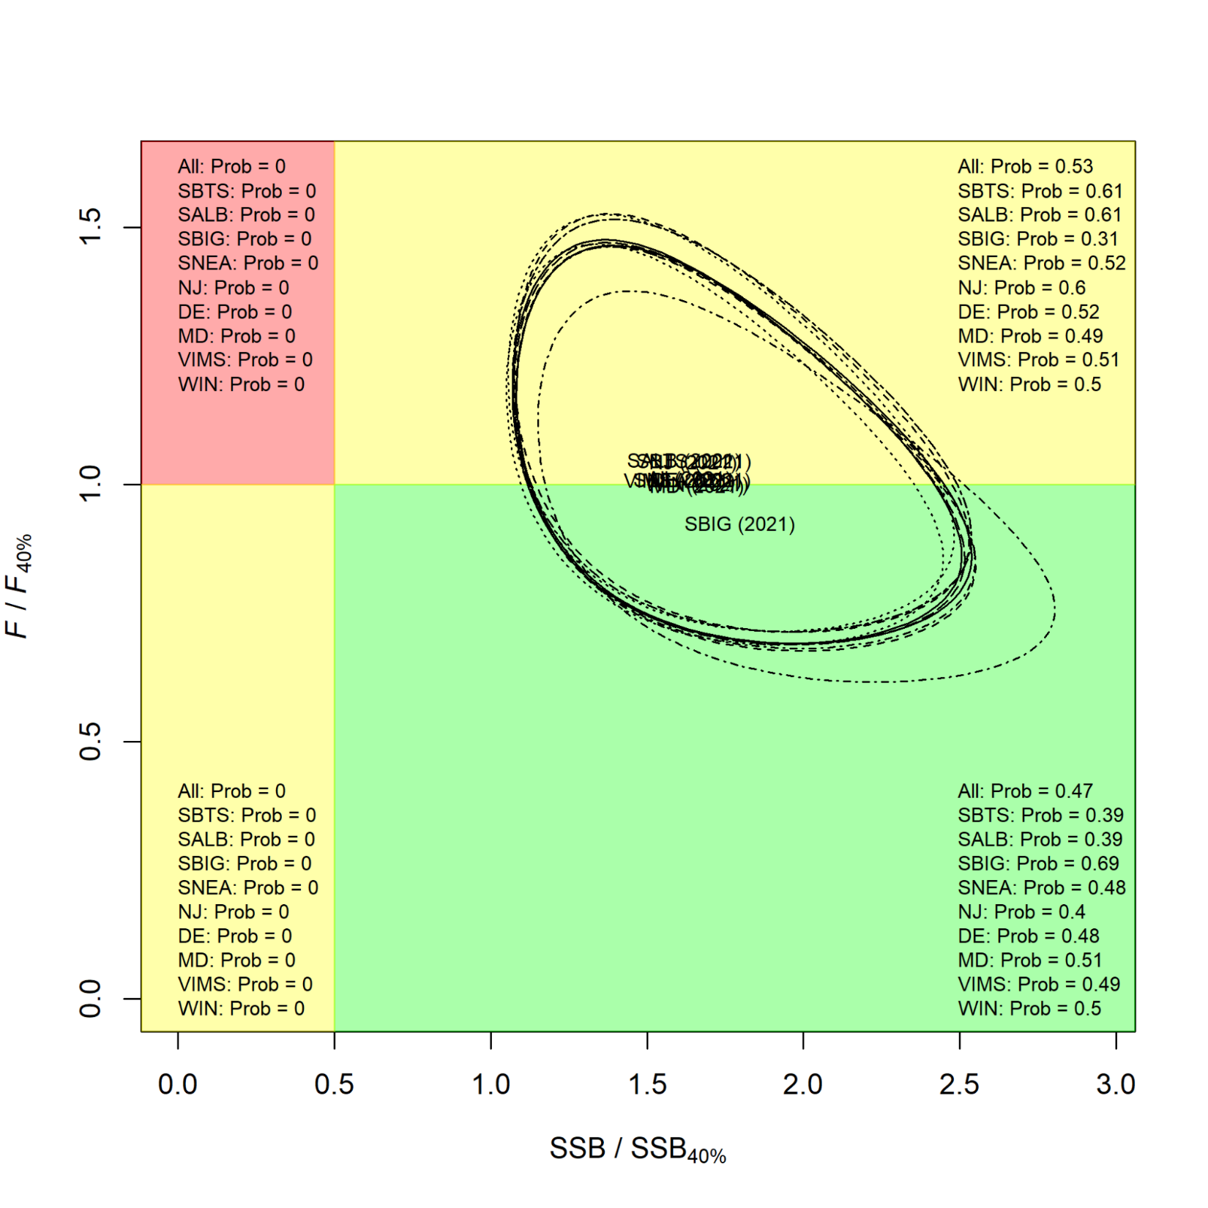

Slide 34
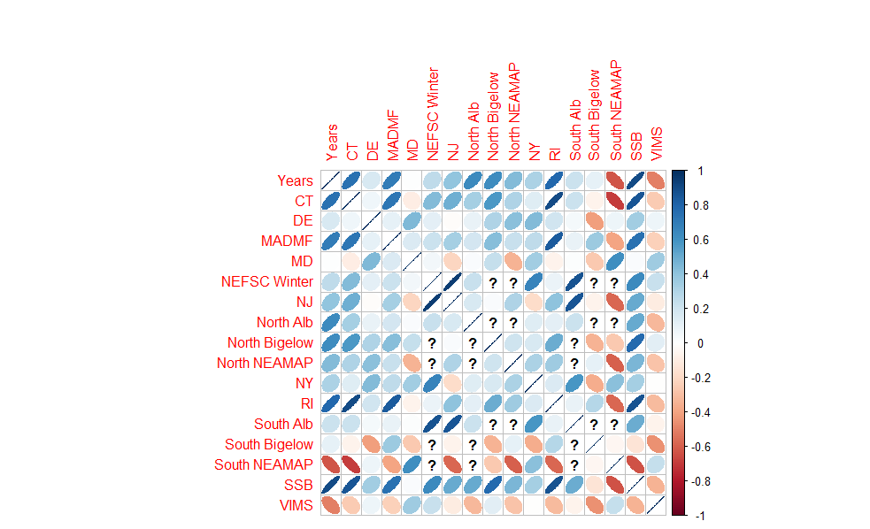

Slide 35
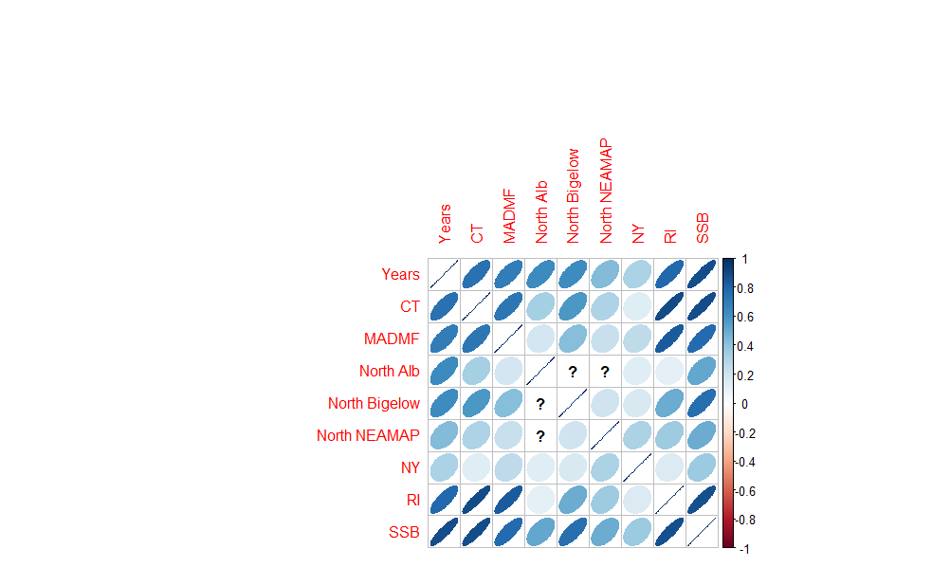

Slide 36
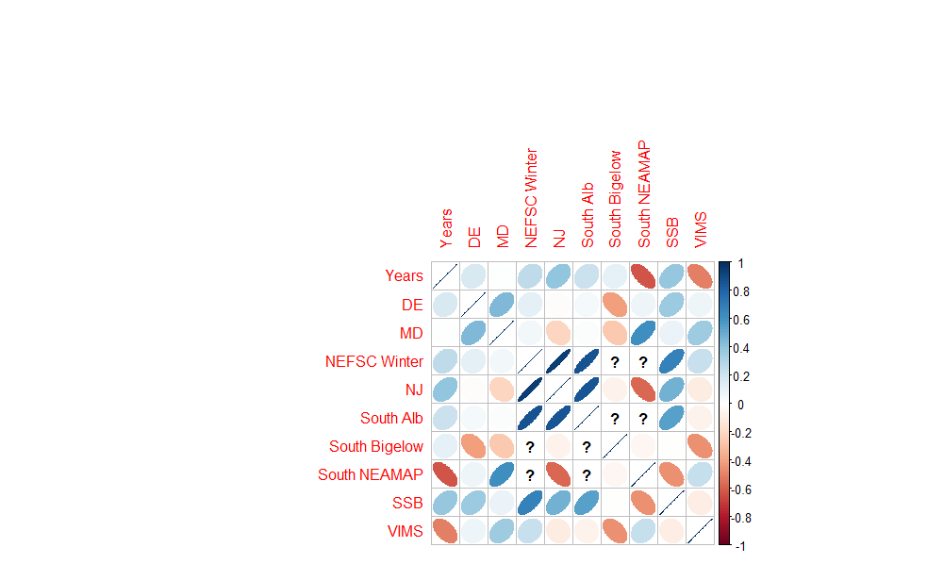

Slide 37
Options for Sensitivity Item 3
Compare WHAM SSB estimates to the number/tow time series from the individual surveys
Compare WHAM run with run with each index individually, rather than the VAST INDEX
Leave-one-out analysis
Compare WHAM run with just NEFSC BTS, NEAMAP, and RecCPA
Examine current VAST model to see if weighting for each survey could be extracted
Re run VAST with just Spring and Fall NEFSC BTS/ NEAMAP

Slide 38
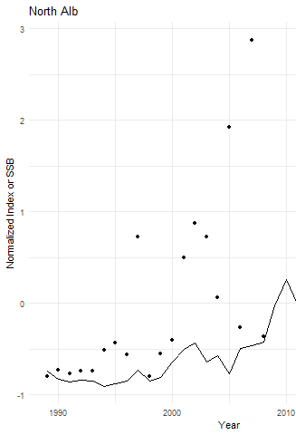
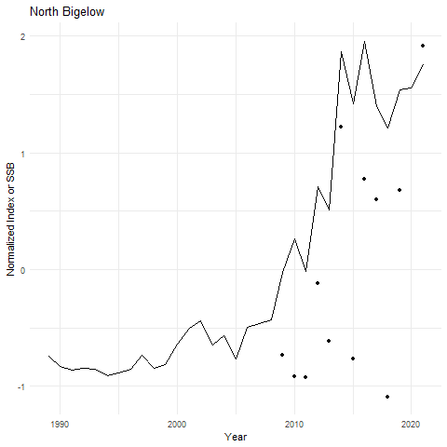
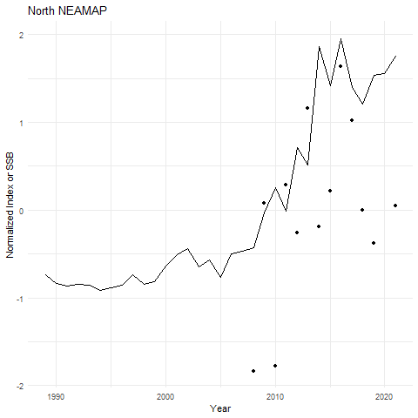
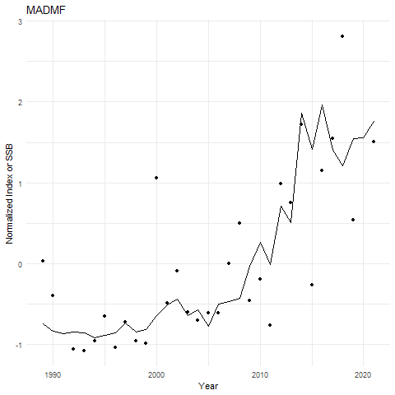
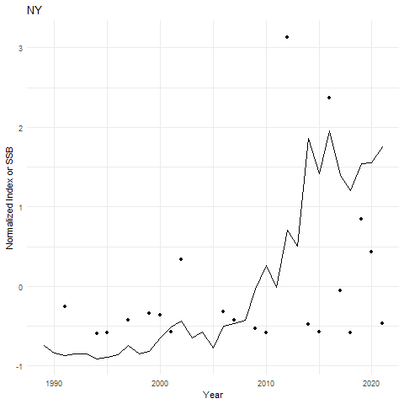
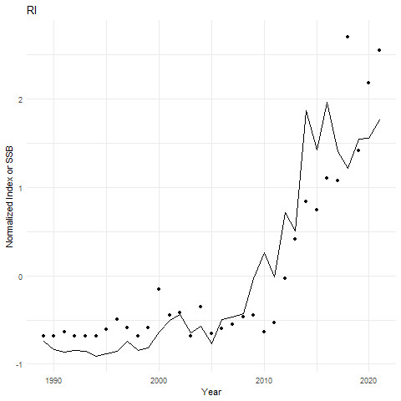
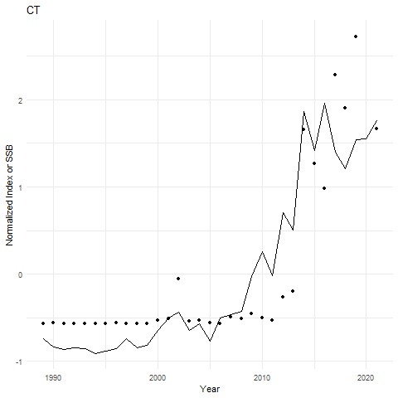
North

Slide 39
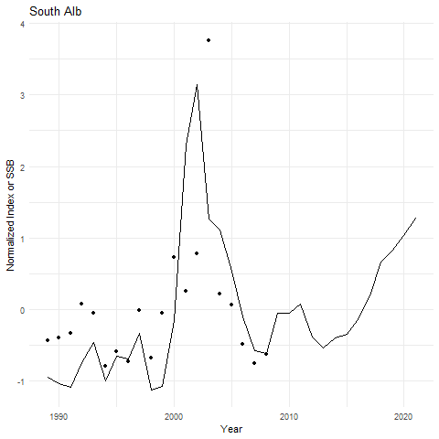
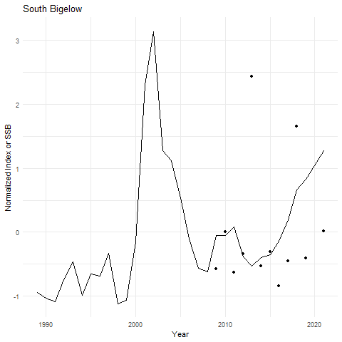
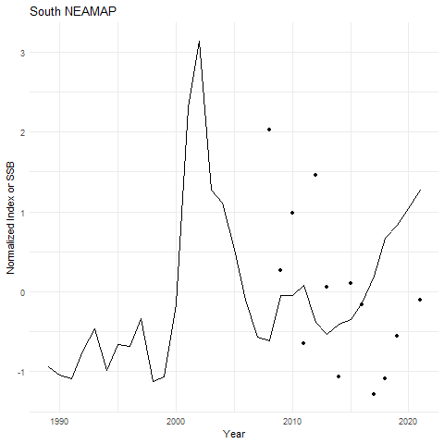
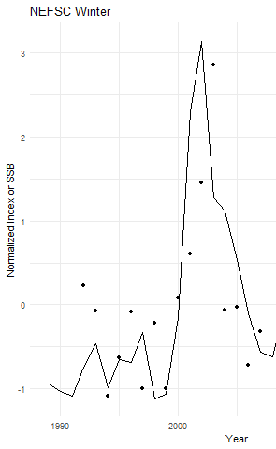
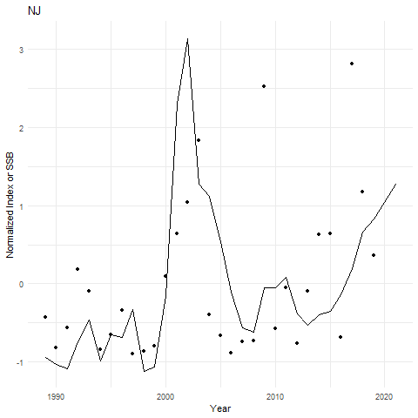
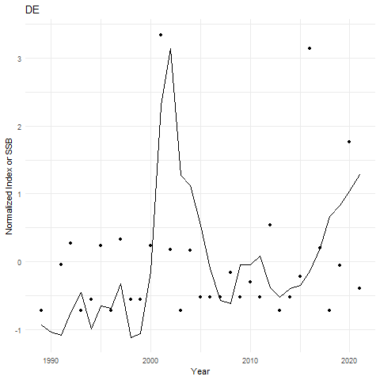
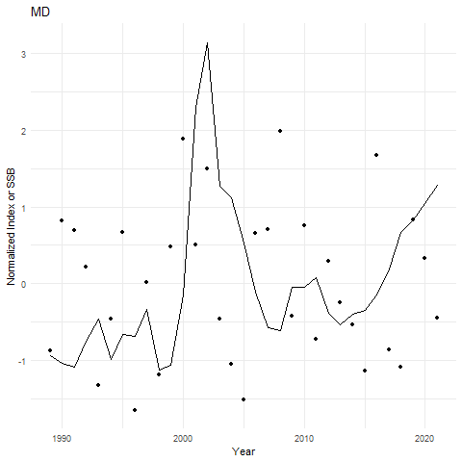
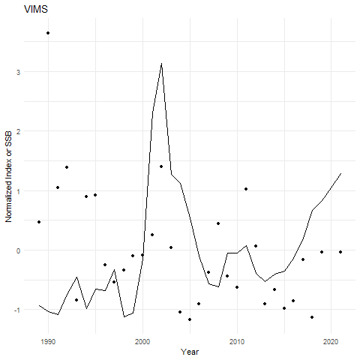
South

Slide 40
Options for Sensitivity Item 3
Compare WHAM SSB estimates to the number/tow time series from the individual surveys
Compare WHAM run with run with each index individually, rather than the VAST INDEX
Leave-one-out analysis
Compare WHAM run with just NEFSC BTS, NEAMAP, and RecCPA
Examine current VAST model to see if weighting for each survey could be extracted
Re run VAST with just Spring and Fall NEFSC BTS/ NEAMAP

Slide 41
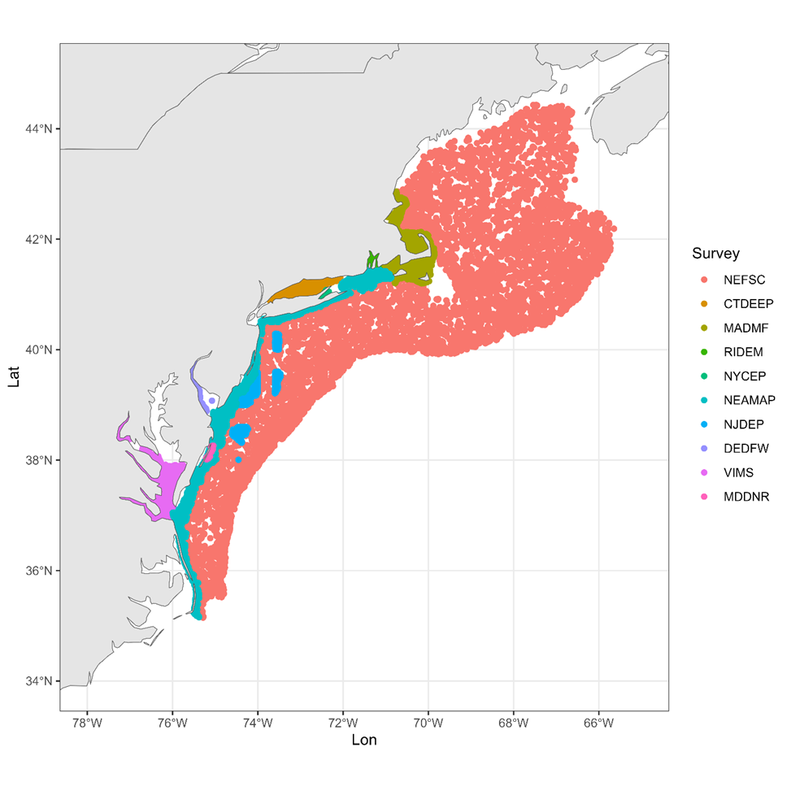


Slide 42
Options for Sensitivity Item 3
Compare WHAM SSB estimates to the number/tow time series from the individual surveys
Compare WHAM run with run with each index individually, rather than the VAST INDEX
Leave-one-out analysis
Compare WHAM run with just NEFSC BTS, NEAMAP, and RecCPA
Examine current VAST model to see if weighting for each survey could be extracted
Re run VAST with just Spring and Fall NEFSC BTS/ NEAMAP

Slide 43
Option 3: Run38 (NEAMAP Spring/Fall?)
Run 34 Indices
Run 38 Indices
North VAST
Sel RE: 2dar1
Age comp: dir-mult
South VAST
Sel RE: none
Age comp: logistic-normal-ar1-miss0
North
Spring Albatross
NEAMAP
Bigelow
Sel RE: none
Age comp: dir-mult
South
Spring Albatross
NEAMAP
Winter BT
Bigelow
Sel RE: none
Age comp: logistic-normal-ar1-miss0
Notes:
Error:
Warning message: In max(tmp) : no non-missing arguments to max; returning -Inf

Slide 44
Option 3: Run38 (NEAMAP Spring/Fall?)
X
Run 34 Indices
Run 38 Indices
North VAST
Sel RE: 2dar1
Age comp: dir-mult
South VAST
Sel RE: none
Age comp: logistic-normal-ar1-miss0
North
Spring Albatross
NEAMAP
Bigelow
Sel RE: none Age comp: dir-mult
South
Spring Albatross
NEAMAP
Winter BT
Bigelow
Sel RE: none
Age comp: logistic-normal-ar1-miss0
Notes:
Error:
Warning message: In max(tmp) : no non-missing arguments to max; returning –Inf
Still working this out with Tim

Slide 45



Slide 46
Conclusions about Sensitivity Test
When the model is fit using the individual indices, there’s a higher recruitment estimated in the north
This causes a higher SSB estimated as well
Some of the indices fit better than others, because of their assumed CV

Slide 47
Sensitivity Tests #1

Slide 48
From FINAL Peer Review Report
Conduct sensitivity analyses including:
1) an exploration of alternative parameterizations for natural mortality (e.g. different age-independent constant values, or age-dependent M)
2) profiles of the initial fishing mortality (i.e. initial depletion)
3) an evaluation of which individual surveys should be included in the VAST index by comparing WHAM estimates (e.g., biomass time series) from the proposed run with individual fishery independent surveys. Surveys that do not appear to accurately reflect changes in stock size through this analysis should not be included in the VAST index.

Slide 49
Options for Sensitivity Item 1
Estimate age-independent M
Fix M at higher or lower values than was used in Run 34
Fix age-dependent M

Slide 50
Options for Sensitivity Item 1
Estimate age-independent M
Fix M at higher or lower values than was used in Run 34
Fix age-dependent M

Slide 51
Run 35-36 (Option 1)
Run 34
Run 35
Age-invariant M fixed at 0.4
One M estimated: 0.732
Run 36
Two M estimated (stock)
North - 0.534
South - 0.778
dAIC AIC rho_R rho_SSB rho_Fbar
Run35 0.0 -1566.0 0.3388 0.0149 -0.0242
Run36 0.8 -1565.2 1.0454 0.2980 -0.2165
Run34 7.8 -1558.2 0.1209 -0.0579 0.0598

Slide 52




Slide 53
Options for Sensitivity Item 1
Estimate age-independent M
Fix M at higher or lower values than was used in Run 34
Fix age-dependent M

Slide 54
Run 39-40 (Option 1)
Run 34
Run 39
Age-invariant M fixed at 0.4
Age-invariant M fixed at 0.6
Run 40
Age-invariant M fixed at 0.2
dAIC AIC rho_R rho_SSB rho_Fbar
Run39 0.0 -1566.3 0.1026 -0.0850 0.0869
Run35 0.3 -1566.0 0.3388 0.0149 -0.0242
Run34 8.1 -1558.2 0.1209 -0.0579 0.0598
Run40 20.8 -1545.5 0.1289 -0.0414 0.0451

Slide 55



Slide 56
Conclusions about Sensitivity Test
M has a strong influence on recruitment and therefore SSB

Slide 57
Sensitivity Tests #2

Slide 58
From FINAL Peer Review Report
Conduct sensitivity analyses including:
1) an exploration of alternative parameterizations for natural mortality (e.g. different age-independent constant values, or age-dependent M)
2) profiles of the initial fishing mortality (i.e. initial depletion)
3) an evaluation of which individual surveys should be included in the VAST index by comparing WHAM estimates (e.g., biomass time series) from the proposed run with individual fishery independent surveys. Surveys that do not appear to accurately reflect changes in stock size through this analysis should not be included in the VAST index.

Slide 59
Options for Sensitivity Item 2
Look at the estimated initial F and the confidence interval. Pick the lower and upper values of the CI and fix them at those values in estimation model

Slide 60
Run 39
Run 34
Run 41
Initial F estimated at
N Com – 0.317
N Rec – 0.527
S Com – 0.315
S Rec – 0.721
F fixed at estimated values
Run 42
F fixed at 95% CI Lower
Run 43
F fixed at 95% CI Upper

Slide 61


Run41 – Fixed at est
Run42 – Fixed at lower
Run43 – Fixed at upper

